Slide 1
International Association of Auto Theft Investigators
Stephen Tully
MVA Investigations

Slide 2
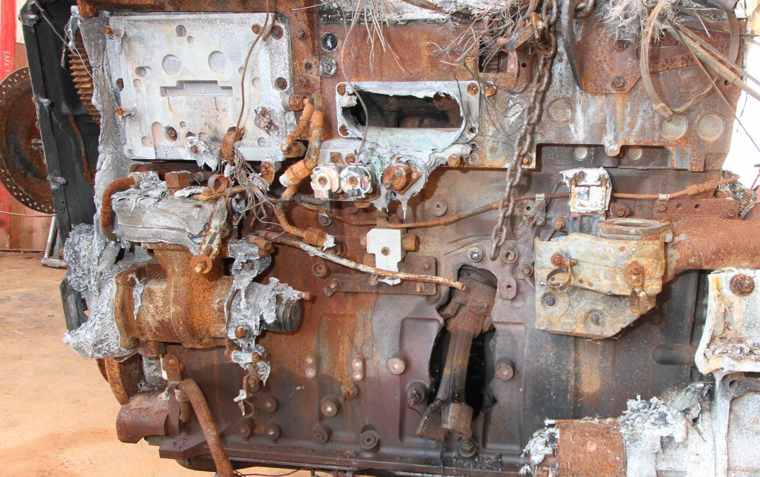
Introduction Forensic Vehicle Examinations
Prepared by Steve Tully of MVA Investigations

Slide 3
Tyre Awareness
Model
B391
Manufactures name
BRIDGESTONE
Production date code: CKL 4301
Tyre size/rating
175/65R14

Slide 4
Tyre Awareness
Tyre sizing and rating
Radial
Tread width
Profile
Load rating
Rim size
Speed rating
Production date code
Week
Year

Slide 5
Tyre Awareness
ROAD TRAFFIC (VEHICLE STANDARDS) RULES 1999
The Road Traffic Act and its Regulations have been re-written as of December 1999 and include the New Australian Road Rules, the Road Traffic (vehicle standards) Rules 1999 and the Road Traffic (miscellaneous) Regulations 1999, which now apply.
Vehicle Standards Part 1 (3) note 1: state, the driver and the owner and the operator of a vehicle driven or towed on a road are each guilty of an offence if the vehicle does not comply with the vehicle standards. Rule 50 of the Vehicle Standards state, a tyre fitted to a vehicle must be free of any apparent defect that could make the vehicle unsafe.
Rule 54 Part 2 (a) (ii) (b) Except at tread wear indicators, a tyre fitted to the vehicle must have a tread pattern at least 1.5 millimetres deep in a band that runs continuously across the tyre width that normally comes into contact with the road, and around the whole circumference of the tyre.

Slide 6
Tyre Awareness
Measure tread depth here
Tread

Slide 7
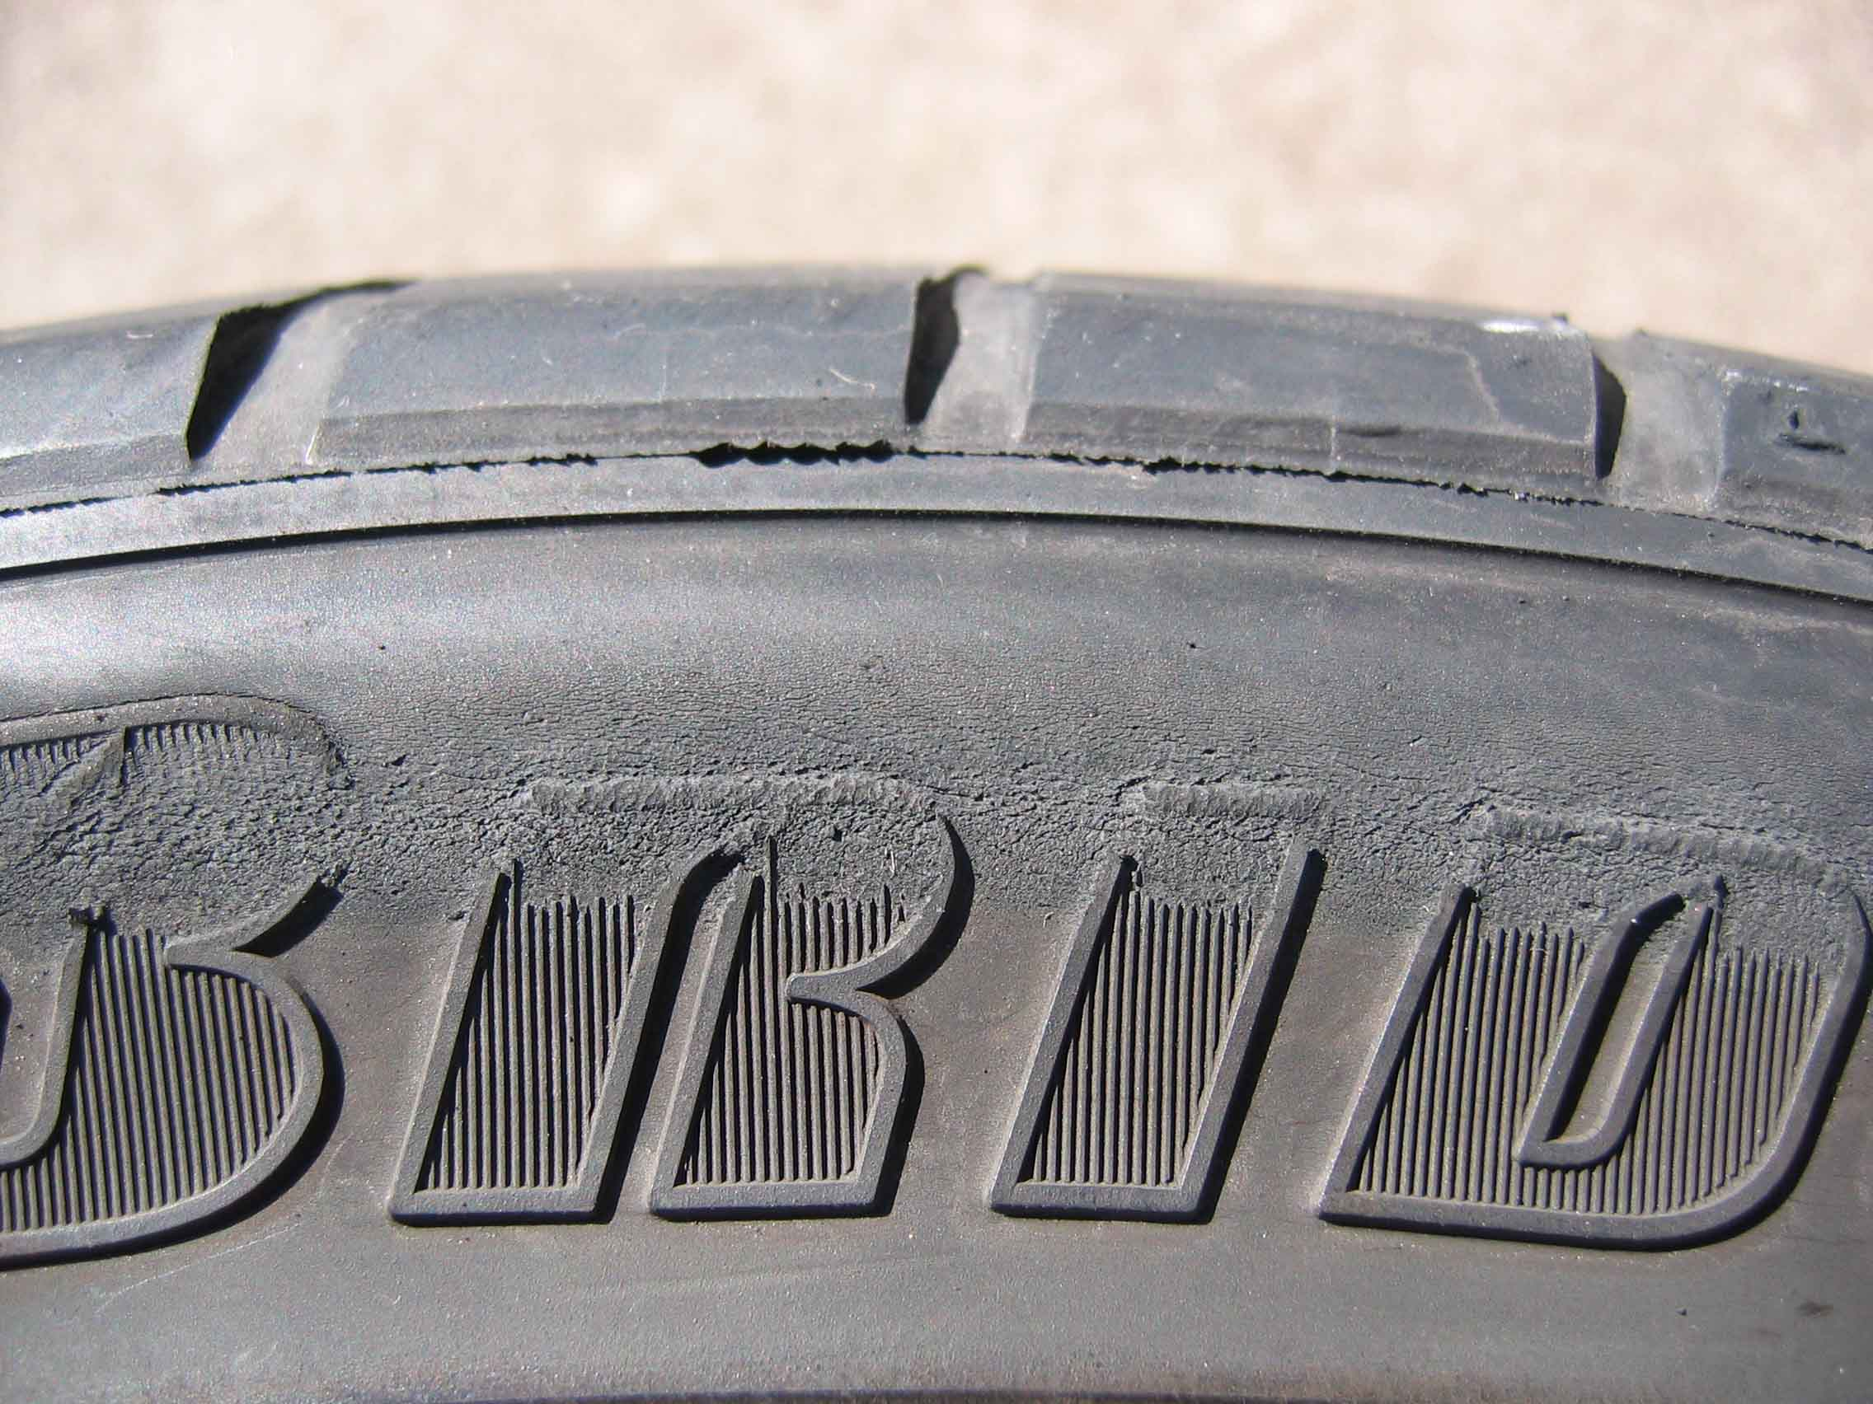
Tyre Awareness
Common tyre faults:
Run under inflated or flat

Slide 8
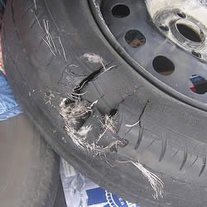
Tyre Awareness
Classic blow out

Slide 9
Tyre Awareness
Impact damage 2

Slide 10
Tyre Awareness
This tyre shows only minor impact damage. But:
Impact damage

Slide 11
Tyre Awareness
when we remove it from the rim: This damage highlights the reason why we need to inspect the inside of the tyre
Classic run flat

Slide 12
Tyre Awareness
Tyre size placard

Slide 13
Tyre Awareness
Road Traffic (Miscellaneous) Regulations 1999—1.1.2010
Part 4—Miscellaneous
(4) The tyres and wheels fitted to a motor vehicle or trailer must be such that—
(a) sufficient clearance is provided so that none of the tyres or wheels will touch
any part of the vehicle, other than at the point of attachment, under operating
conditions; and
(b) none of the tyres protrudes beyond the mudguard or body structure when
viewed from above with the wheels in a straight ahead position.
(5) Despite the requirements of any other regulation or rule under the Act, a motor vehicle
that is required to comply with ADR 24 or the tyre and rim selection requirements of
ADR 42 may be—
(a) equipped with tyres other than those listed on the tyre placard fitted to the
vehicle, provided that—
(i) the load of a tyre fitted is not less than the lowest load listed on the
tyre placard; and
(ii) the overall diameter of a wheel and tyre fitted is not more than
15 millimetres greater than the largest tyre size listed on the placard and not more
than 15 millimetres less than that advised on the placard.

Slide 14
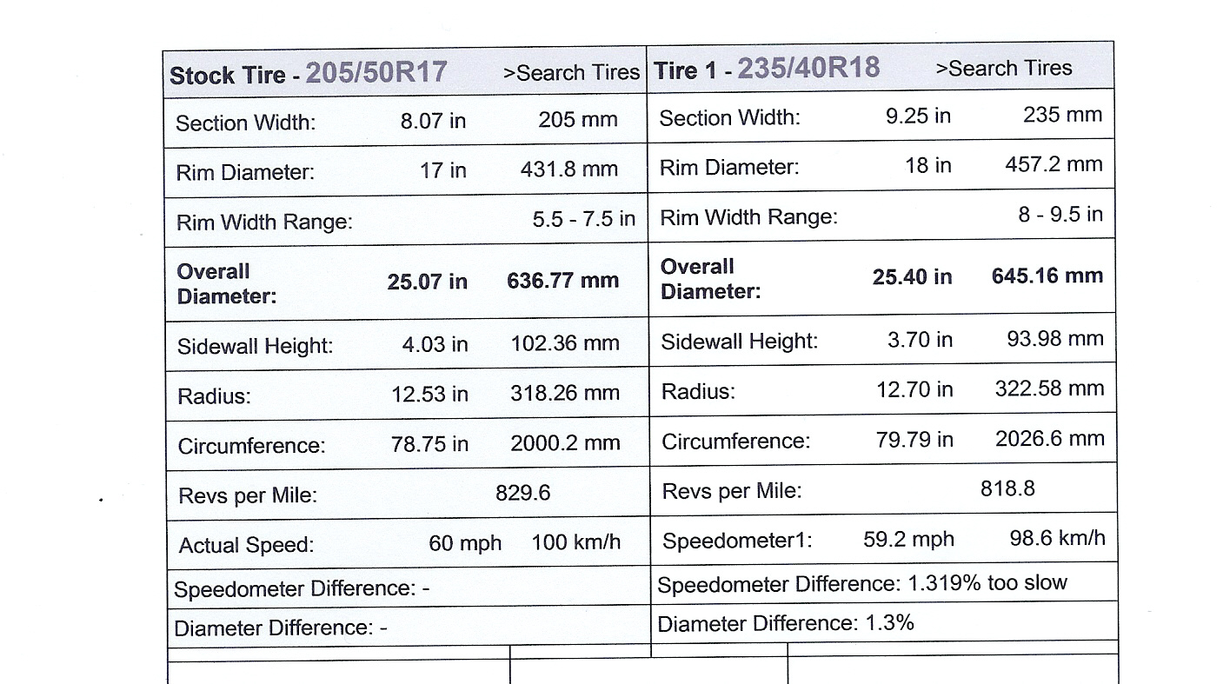
Tyre Awareness
8.39mm
WWW.1010Tires.com

Slide 15
Tyre Repair

Slide 16
Tyre Repair

Slide 17
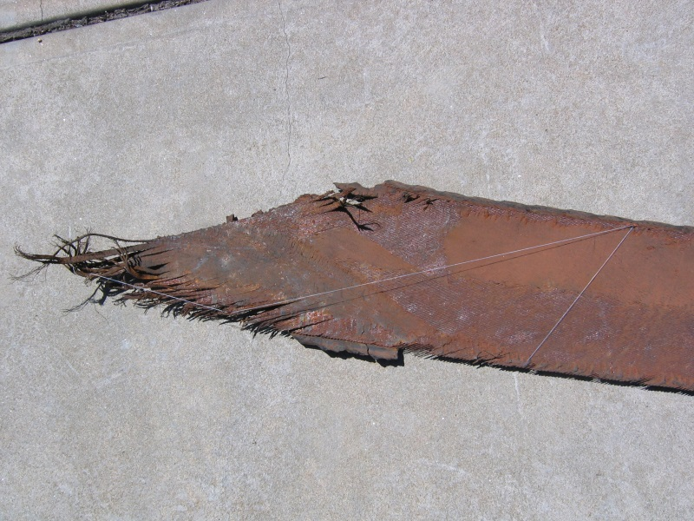
Tyre Repair

Slide 18
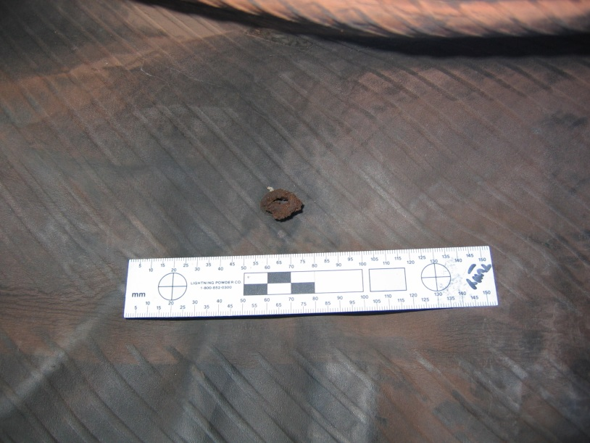
Tyre Repair

Slide 19
Tyre Repair

Slide 20
Hoon Driving

Slide 21
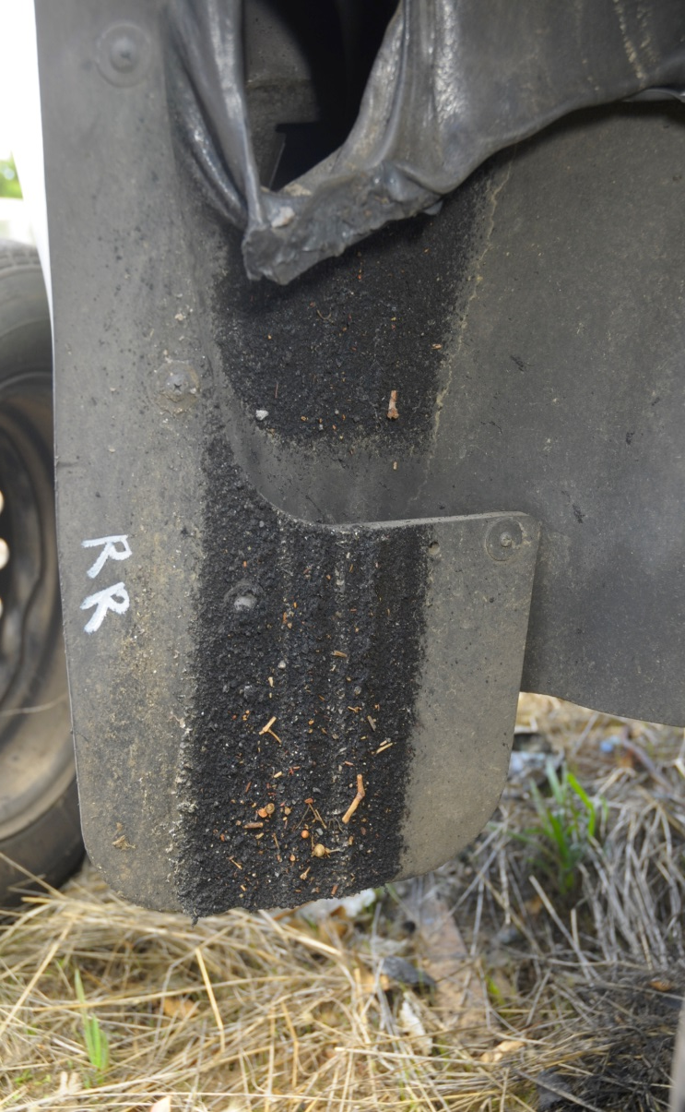
Hoon Driving

Slide 22
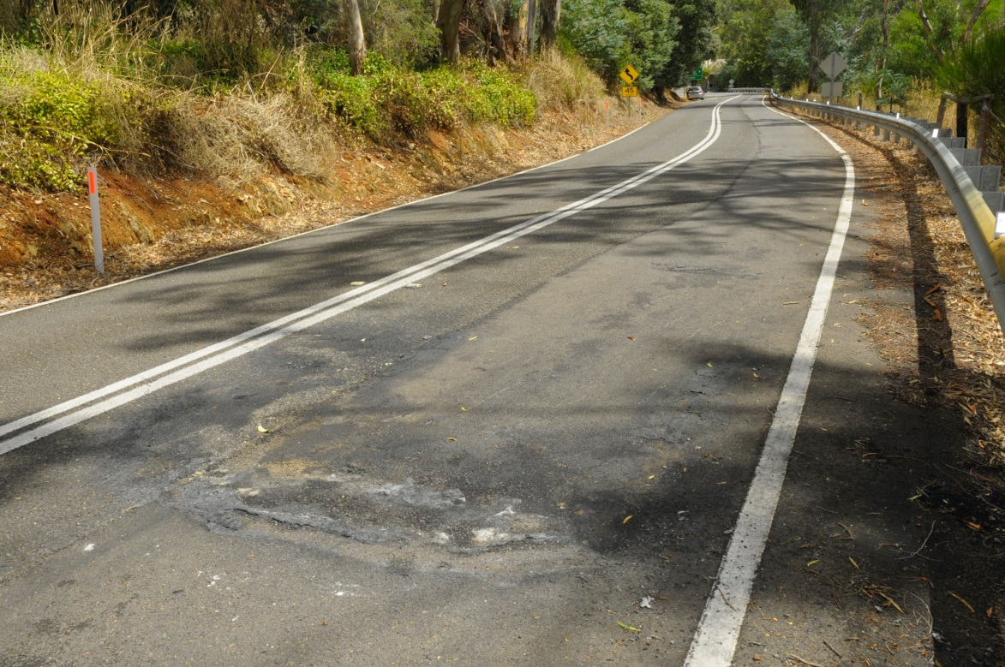
Hoon Driving

Slide 23
Hoon Driving

Slide 24
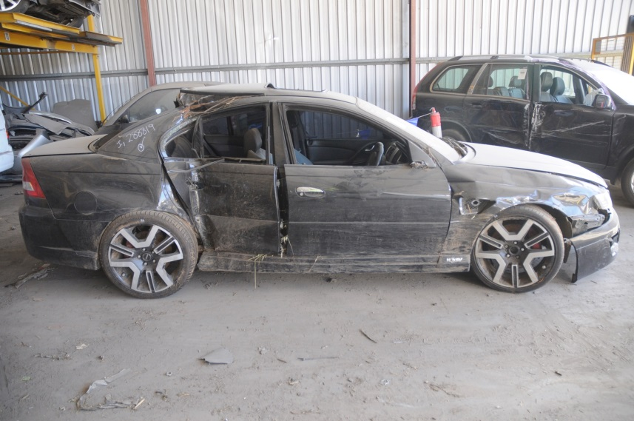
Vehicle Modifications

Slide 25
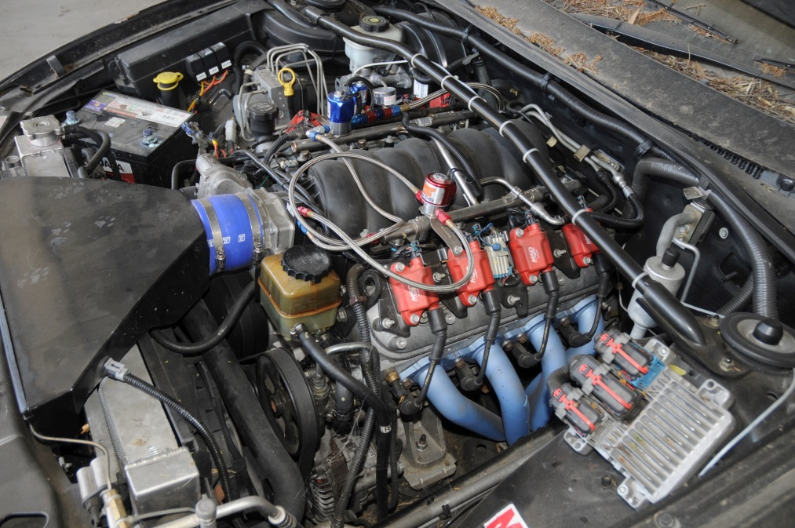
Vehicle Modifications

Slide 26
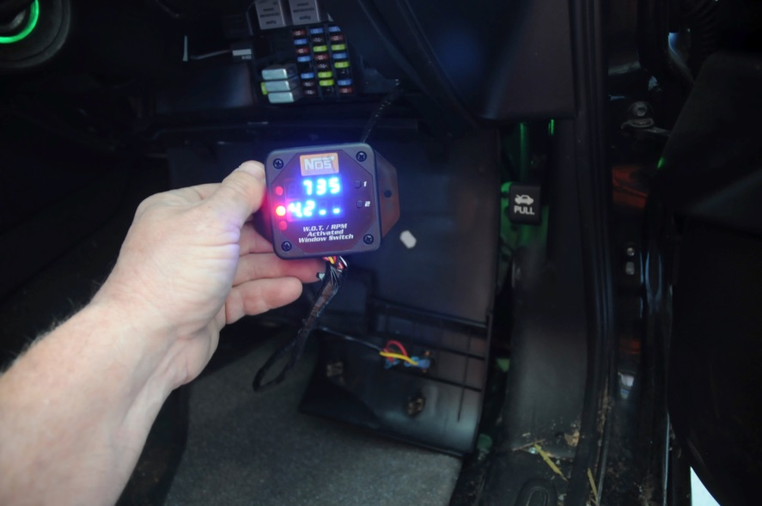
Vehicle Modifications

Slide 27
Vehicle Modifications

Slide 28
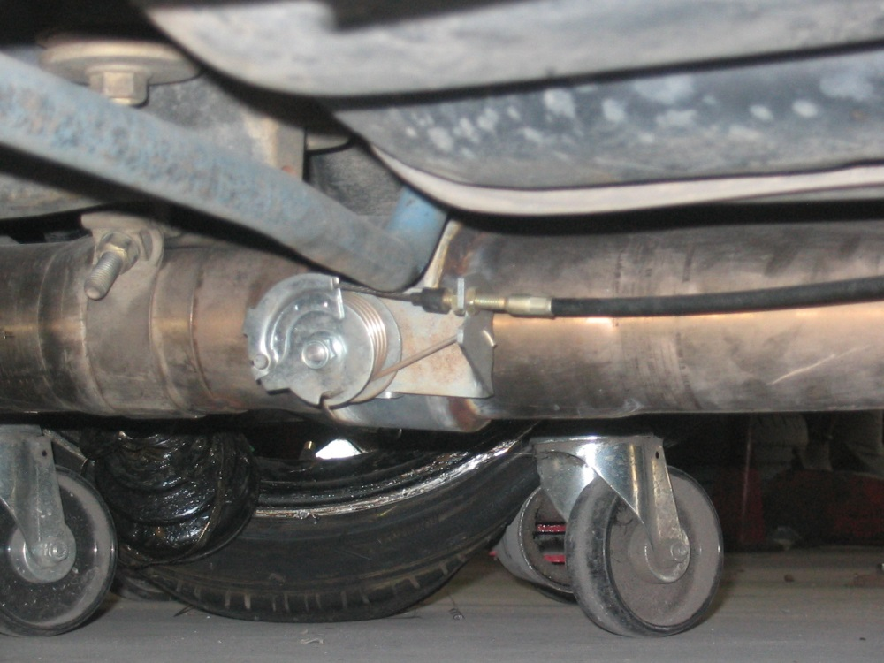
Vehicle Modifications

Slide 29
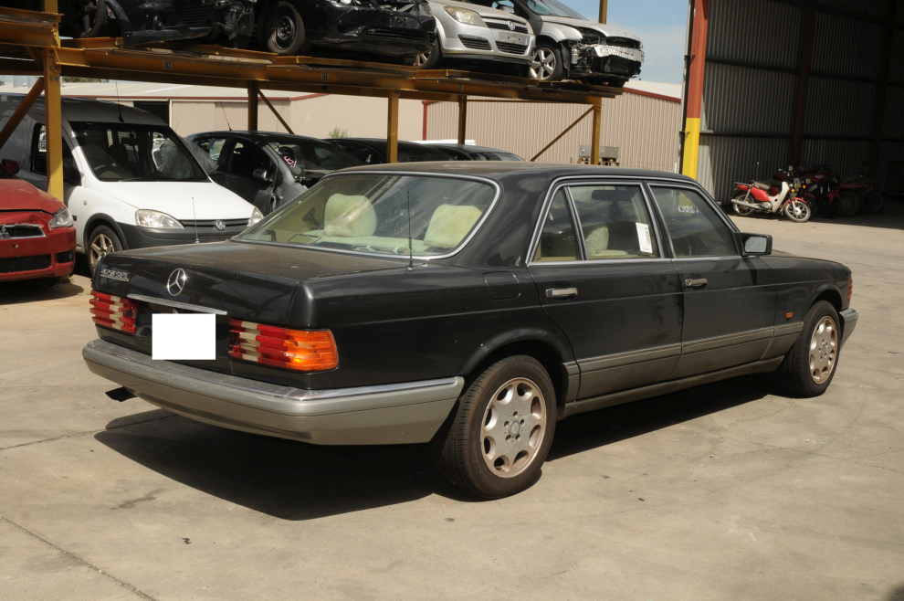
Fraud Claim

Slide 30
Fraud Claim

Slide 31
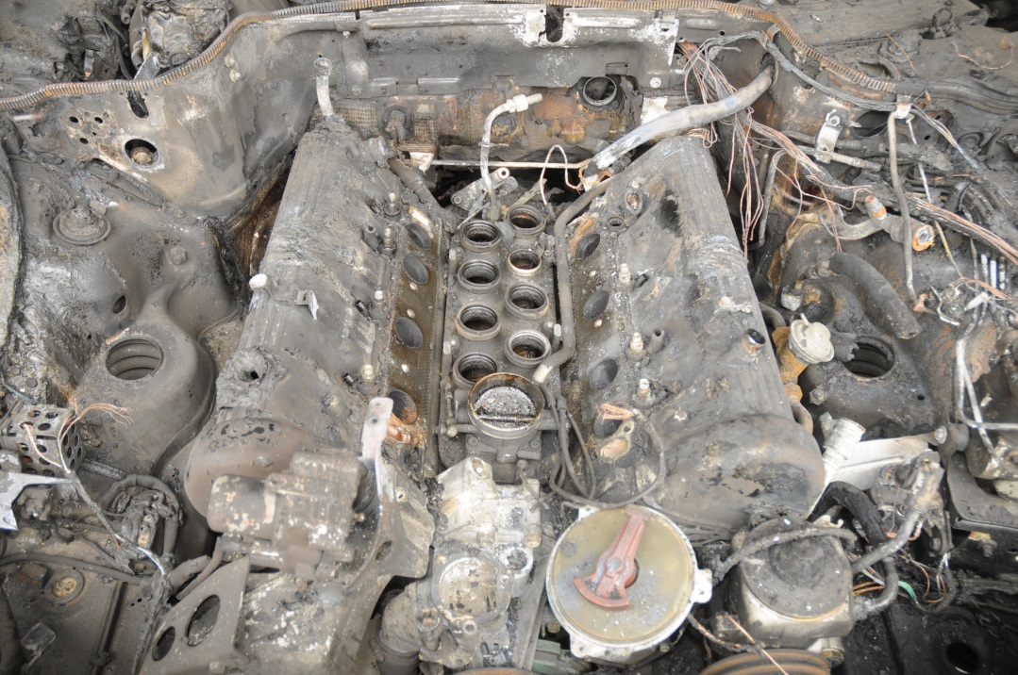
Fraud Claim

Slide 32
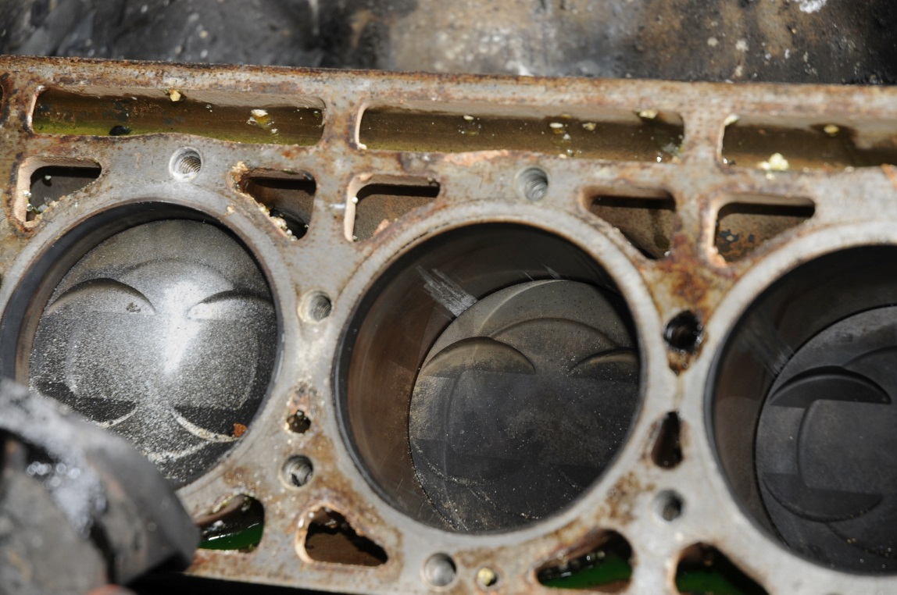
Fraud Claim

Slide 33
Fraud Claim

Slide 34
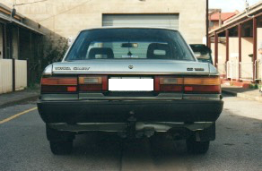
Fraud Claim

Slide 35
Fraud Claim

Slide 36
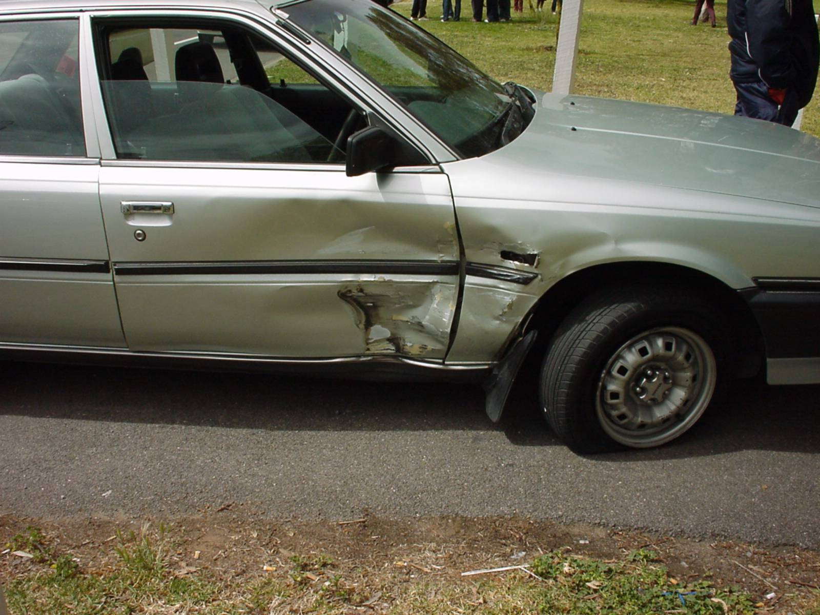
Fraud Claim

Slide 37
Fraud Claim

Slide 39
Vehicle Damage

Slide 40
Vehicle Damage

Slide 42
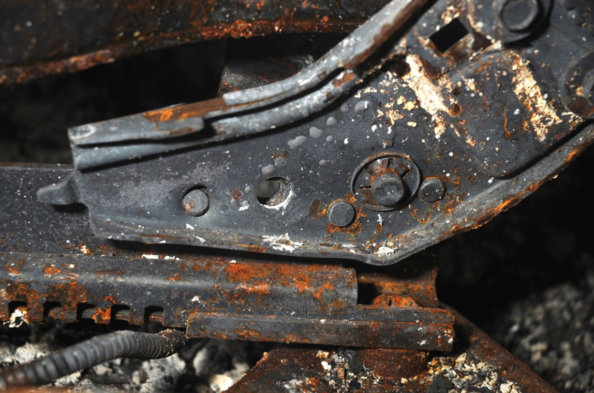
Seat Belts

Slide 43
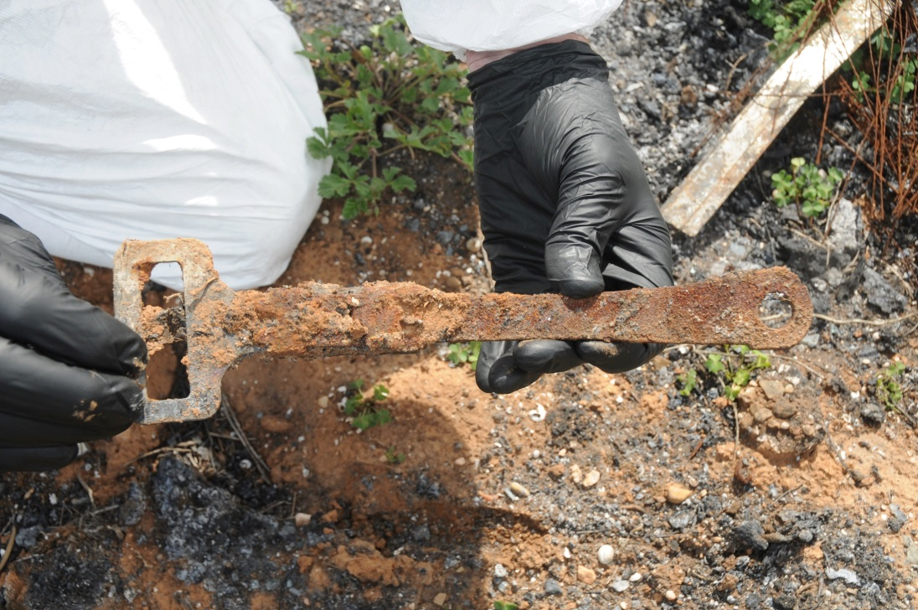
Seat Belts

Slide 45
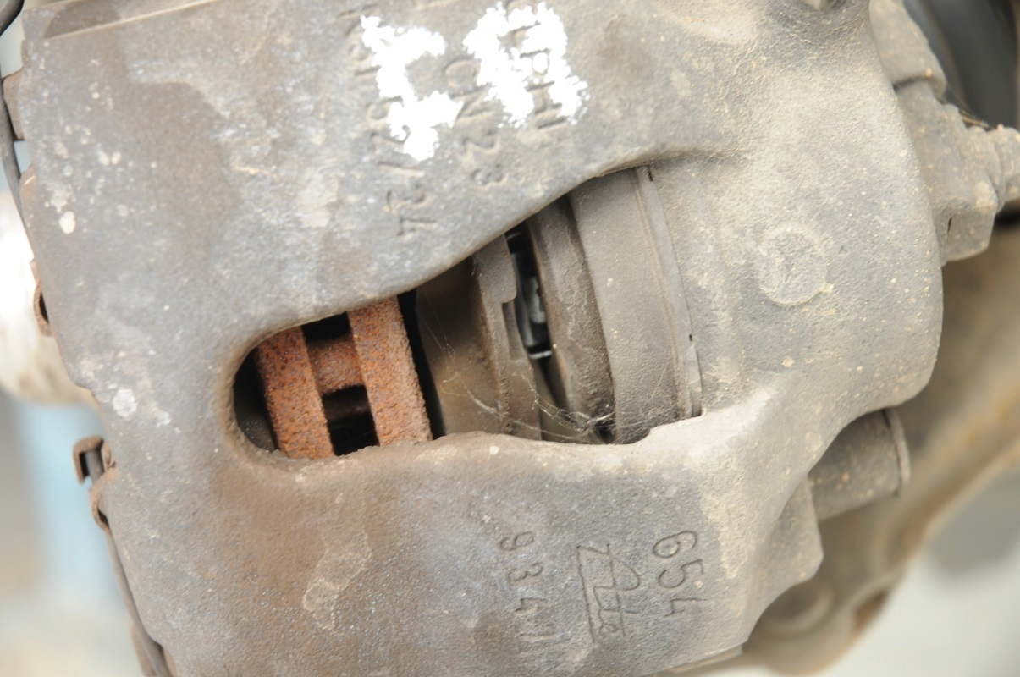
Brakes

Slide 46
Light globes

Slide 47
Light globes

Slide 48
Filament damage
Notes:
)

Slide 49
Mechanical Fire

Slide 50
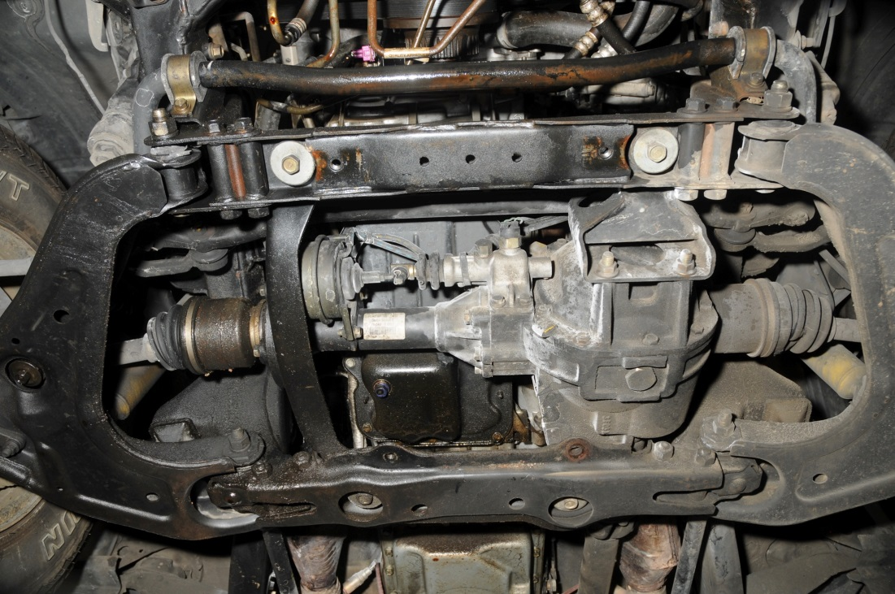
Mechanical Fire

Slide 51
Mechanical Fire

Slide 52
Mechanical Fire

Slide 53
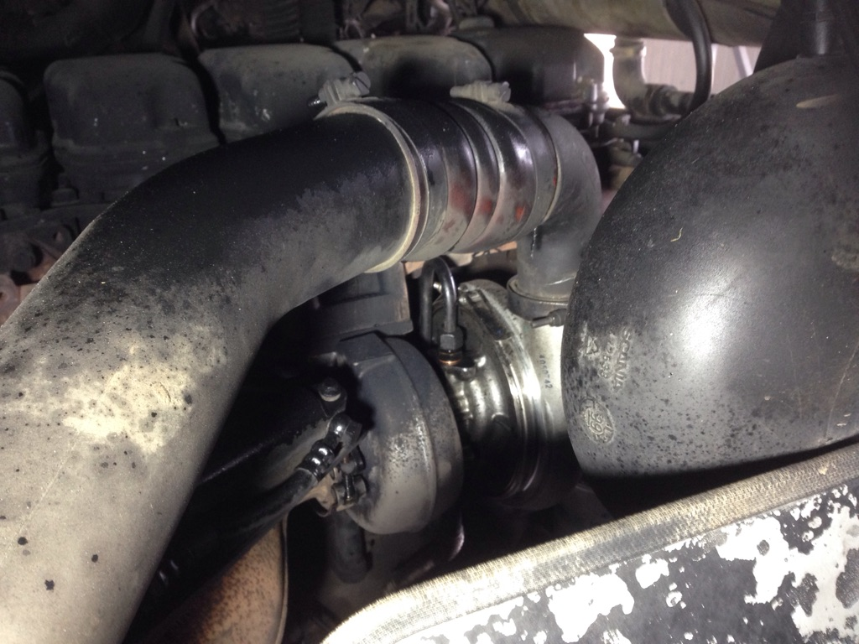
Mechanical Fire

Slide 54
The End

