Slide 1
International Association of Auto Theft Investigators
Robert Ishak
William Roberts Lawyers

Slide 3
THE POWER OF NEGOTIATION
by ROBERT ISHAK
L22, 66 Goulburn Street L21, 535 Bourke Street L8, 300 Ann Street L26, 30 Cecil Street
SYDNEY NSW 2000 MELBOURNE VIC 3000 BRISBANE QLD 4000 SINGAPORE 049712
+ 61 2 9552 2111 + 61 3 9321 9111 + 61 7 3894 0780 + 65 6637 8936
2

Slide 4
WHAT IS NLP?
NLP stands for Neuro-Linguistic Programming
Neuro - explores the relationship between how we think
Linguistic - explores how we communicate
Programs - as these are the patterns of our behaviour and emotions
3

Slide 5
WHAT IS NLP?
NLP is a change management tool
that transforms the way people
think
relate to one another
4

Slide 6
TODAY’S FOCUS ON NLP
RELATONSHIP YOU HAVE WITH YOUR CLIENT IN A NEGOTIATION CONSTRUCT
5

Slide 7
REALITY
One must first accept that everyone has a different reality
Find out what the client’s real problem is rather than the one they say it is
It is important to learn to relate to your client first and understand their needs
6

Slide 8
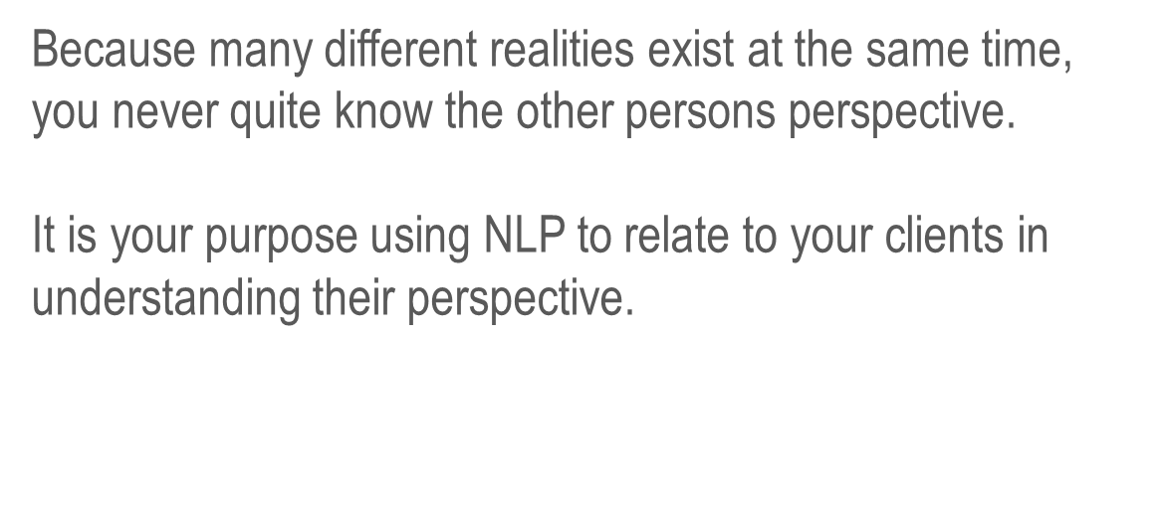
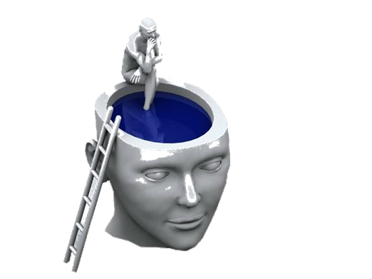
PERSPECTIVE
7

Slide 9
SETTING YOUR INTENTION
Practise more than other NLP techniques
Read The Power of Intention by Dr Wayne Dwyer
Prepare by setting your intention and your state
‘If I had six hours to chop down a tree. I’d spend the first three hours sharpening the axe’
Abraham Lincoln
8

Slide 10
SETTING YOUR INTENTION
I will understand the client’s reality
2. I will relate to the client
I will have empathy for the client’s situation. I will stand in the client’s shoes and look through their eyes and feel their experience
At the end of the conversation, the client will feel comforted, well understood and reassured that we care for them
9

Slide 11
LISTENING
Do not interrupt, let the client have their say
10

Slide 12
KEYWORD BACKTRACKING
Is used to reframe a conversation and maintain control of the conversation by holding the frame
“Thank you for that explanation. It was great that you went into so much detail. Is it correct to say… [reframe and detail the issue]”
11

Slide 13
KEYWORD BACKTRACKING
This then allows you to:
Reframe their experience
Demonstrate you truly relate
Put a steer on the conversation if you need
Move the conversation towards resolution
12

Slide 14
KEYWORD BACKTRACKING
Listen to key words
“You do not UNDERSTAND. This is really INCONVENIENT. Your actions have really hurt my FAMILY”
In using the client’s language you keep connected
13

Slide 15
MATCHING & MIRRORING
Another key principle of NLP
Posture
Tonality
MONITOR
Tonality
Gestures
14

Slide 16
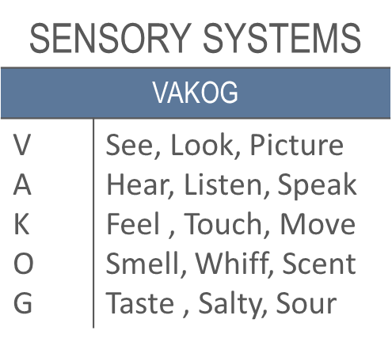
RAPPORT & SENSORY SYSTEMS
RAPPORT
PHYSICAL | VOCAL
Posture Gesture | Speed Volume Key words
Noticing which sensory system the client is using will allow you to use that language
15

Slide 17
EYE MOVEMENT
We move our eyes in certain directions when accessing different parts of the brain
When we visualise or imagine something, we look up
When we are feeling an emotion or talking to ourselves, we look down
You can tell how people are thinking
16

Slide 18
EYE MOVEMENT
Visual Construct
Visual Remembered
Auditory Construct
Auditory Recall
Kinaesthetic Response
Auditory Digital
17

Slide 19
EYE MOVEMENT
This information is useful for many reasons:
1. Discovering how people are processing information
Processing visually - use phrases such as “I see what you mean” or “That looks good” or “Things are looking bright”
Processing auditorilly - use phrases such as “I hear you” or “That sounds good” or “That resonates with me”
Processing kinaesthetically - use phrases such as “I get it” or “I feel like it” or “That’s a solid idea”
18

Slide 20
EYE MOVEMENT
Discovering whether people are telling the truth
If you ask your employee where they were on their sick day, and their eyes go to visual construct, they may be making up the answer
If you ask your spouse what your neighbour looks like naked and they go to visual recall, you may be in for some bad news
If you ask your friend what the person who has a crush on you said and they go to auditory recall, it is likely they are telling the truth
19

Slide 21
SUMMARY
Coaching your client to an outcome is all about asking questions
It is not about selling your point of view
You must first appreciate the present state if you are to have any hope of moving to a desired state
20

Slide 22
SUMMARY
The problem they tell you is often not their real problem
It may require asking open questions:
“How does it make you feel?”
“What inconvenience has this caused you?”
21

Slide 23
SUMMARY
NLP can be used to connect to a client and then steer a person’s reality and their sense of fairness and context, to a direction of your choice
It is not manipulation that is unethical if the intention you set is to:
Improve their life;
Bring them peace; and
Help them understand the equity and fairness
22

Slide 24
Q&A
THANK YOU FOR YOUR TIME
23

Slide 25
williamroberts.com.au
24

