Slide 1
Insurance Fraud Enforcement Department
Establishing the IFED – the hurdles faced and the lessons learned

Slide 2
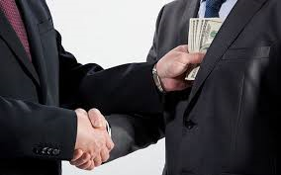
This is okay, right ?

Slide 3
Shared aims

Slide 4
Why the City of London police

Slide 5
The Cycle
The Cycle
More Fraud
Less Police Investigation
No Deterrent

Slide 6
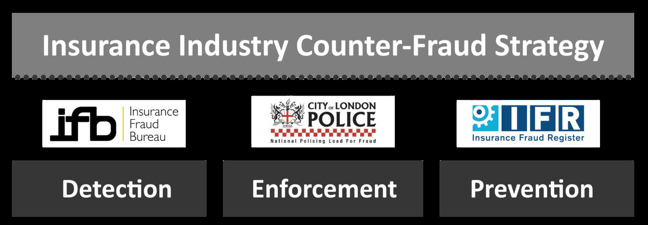
Industry wide strategy

Slide 7
Value for money

Slide 8
Core Principles
Accountability
Transparency
Impartiality

Slide 9
How do we make this work?
Law Enforcement
Bring everyone together
Insurance
Notes:
Law enforcement + Insurance “seeing each others perspective”

Slide 10
How do we make this work?
Law Enforcement
Bring data together
Insurance
Notes:
Pool statistics – at individual level (compare different types of insurance fraud) + bigger picture – patterns

Slide 11
How do we make this work?
Law Enforcement
Not just insurance fraud
Insurance
Notes:
Understand wider criminality it feeds
IFED is a cog in the law enforcement wheel

Slide 12
How do we make this work?
Law Enforcement
Not just crash for cash
Insurance
Notes:
Started in Motor – that’s where we first saw the large scale fraud, now happens in other sectors – slip and trip for e.g.
Insurance needs to pool information between silos

Slide 13
QUESTIONS?

