Slide 1




International Association of Auto Theft Investigators
Nigel Carson and Tim Myers
KordaMentha Forensic

Slide 2
Digital Forensics in Vehicle Crime Cases
IAATI Conference 2017
6 April 2017

Slide 3
Summary
      What is computer Forensics and the digital revolution
      Forensic collection and types of devices
      The advantages of ‘Forensic imaging' over file copy
      Rise of the mobile phone
      Social media
      Photo Forensics and metadata
      Case Studies on photo forensics
      Summary and conclusion

Slide 4

What is computer Forensics?
  The process of identifying, preserving, analysing and presenting digital evidence in a manner that is legally acceptable in any judicial or administrative hearing.

Slide 5
Where does it come from?
Expanding source of Electronically Stored Information (ESI)
Personal computers
Server computers
Communication
Multimedia
      Desktop and Notebook
      Portable storage
      (CD/DVD, USB thumb drives, USB external hard drives)
      File
      Internet (web, e-mail)
      Database
      Remote access
      Storage
      (NAS, SAN, Tape)
      Mobile phone
      Smartphone and PDA
      GPS navigation
      Multifunction printer
      Cloud computing
      Media player (iPod)
      Digital still/video camera
      Digital voice recorder
      Digital video recorder
      Gaming (PS3, Xbox)

Slide 6
Where does it come from?
Electronic documents - Internet locations
Social networking
Content sharing
Communication
      Facebook
      LinkedIn
      Instagram
      Twitter
      Google Plus
      Dropbox
      Google Drive
      One Drive
      Salesforce CRM
      YouTube
      Office 365
      Communication
      Skype
      WhatsApp
      Viber
      iMessage

Slide 7
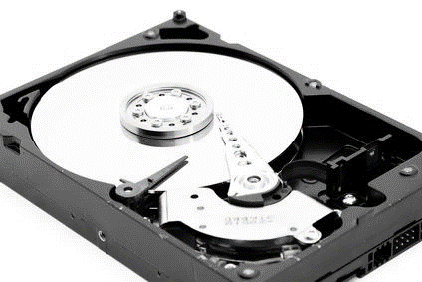
Computer Forensic principles
      Don’t change the evidence
      Document results – repeatability
      Maintain chain of custody
      Don’t mishandle evidence
      Don’t work on original evidence
Notes:
Evidence Handling is one of the cornerstones of Forensic Technology. All procedures followed must be court acceptable. In any Forensic Investigation, always treat electronic media as evidence.

Slide 8
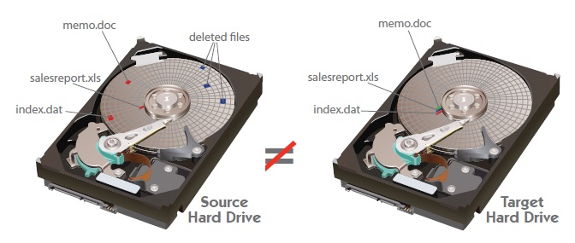
Preservation
Forensic image versus File Copy
      File copy
Source: http://www.pinpointlabs.com/images/trialgraphics/ForensicImageVsActiveFile.pdf
Notes:
Difference between Forensic Image vs Active file collections
Forensic Image (Clone)
► Allows deleted information (files, email, user logs) to be recovered from source media.
► A Forensic image or clone copies the entire contents of the source media including unallocated space.
► A large quantity of data can usually be viewed and recovered from the source media even when it isn’t visible in the host computers operating system (i.e. Microsoft Windows).
Active File (Logical) Collections
► If a Forensic investigation isn’t required an active file collection can reduce costs and the size of the overall file collection.
► Active file collections includes copying files that are currently accessible from the host operating system (i.e. Microsoft Windows).
► Files collected from corporate servers (file shares) commonly use active file collection because it can be cost prohibitive to image servers, the amount of irrelevant data and
the inconvenience of shutting down servers or the time required for a live acquisition.

Slide 9
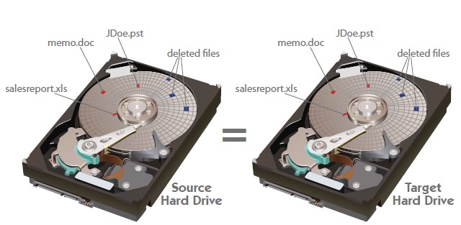
Preservation
Forensic image versus File Copy
      Forensic Image – hard drive frozen in time
      Verified by a mathematical formula to ensure exact copy
Source: http://www.pinpointlabs.com/images/trialgraphics/ForensicImageVsActiveFile.pdf
Notes:
Difference between Forensic Image vs Active file collections
Forensic Image (Clone)
► Allows deleted information (files, email, user logs) to be recovered from source media.
► A Forensic image or clone copies the entire contents of the source media including unallocated space.
► A large quantity of data can usually be viewed and recovered from the source media even when it isn’t visible in the host computers operating system (i.e. Microsoft Windows).
Active File (Logical) Collections
► If a Forensic investigation isn’t required an active file collection can reduce costs and the size of the overall file collection.
► Active file collections includes copying files that are currently accessible from the host operating system (i.e. Microsoft Windows).
► Files collected from corporate servers (file shares) commonly use active file collection because it can be cost prohibitive to image servers, the amount of irrelevant data and
the inconvenience of shutting down servers or the time required for a live acquisition.

Slide 10
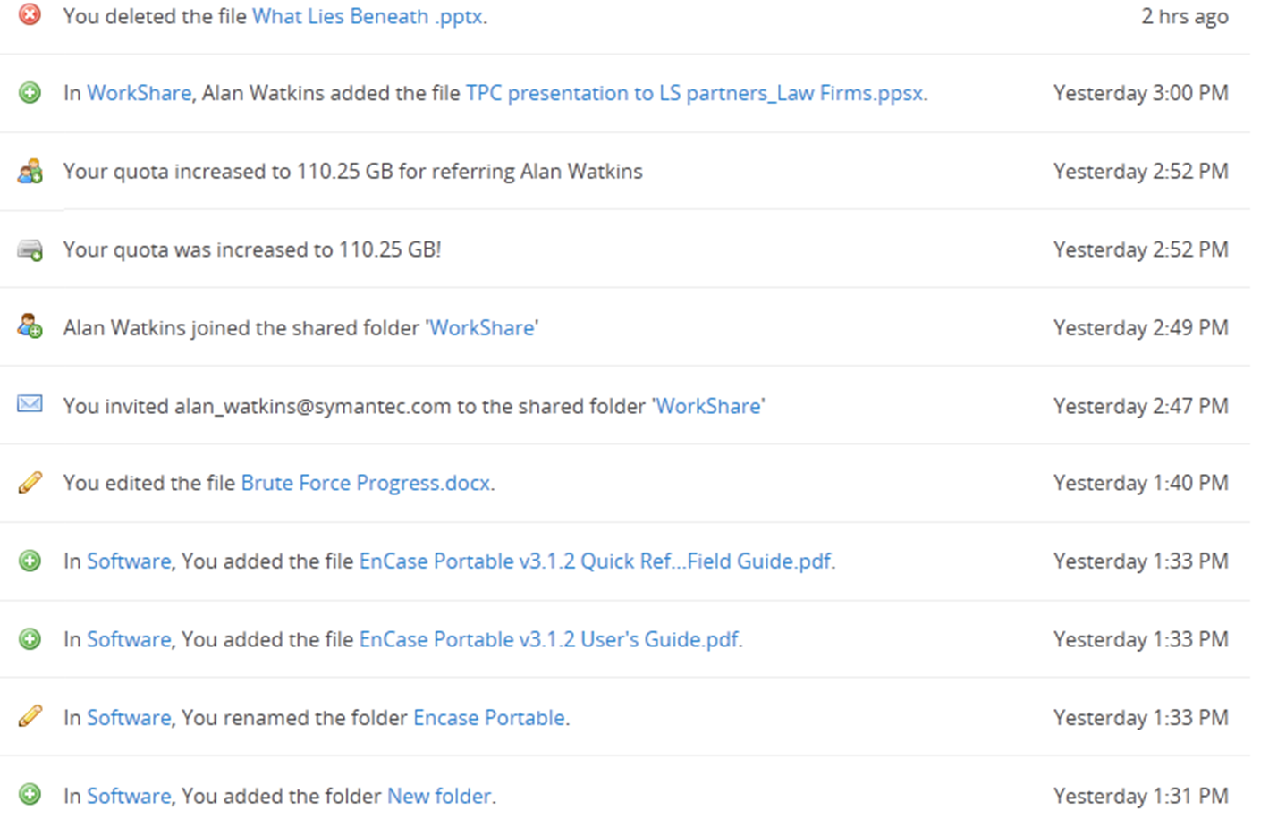
Cloud evidence
      Dropbox – event logs
      Dropbox – synched devices
      IMAP download – email
      Google Docs – OneDrive
      iCloud drive
      iCloud backups
Dropbox event logs

Slide 11

Electronic documents
Key features
Iceberg principle
      Much of what we deal with is hidden to the standard user
        e.g. Deleting file =/= file is completely gone
Notes:
The iceberg illustrates the difference between what data the average user can see compared to what data is actually available to find. Most data is 'hidden beneath the surface' – beyond the simple windows view. This includes metadata, deleted files and unallocated space from the disk.

Slide 12
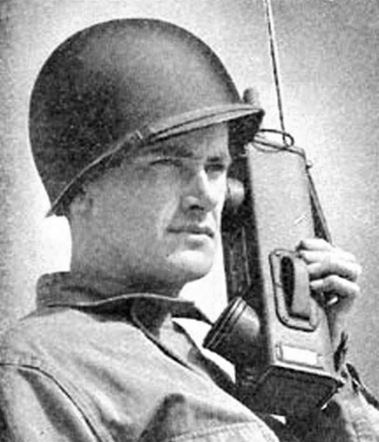
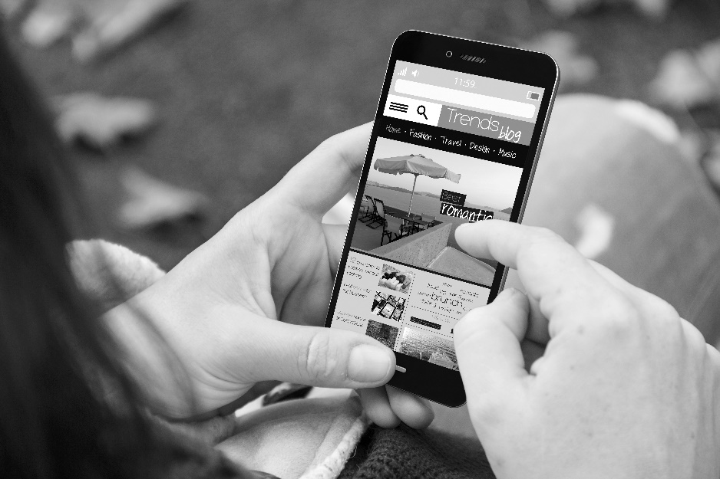
Rise of the mobile phone
SOURCE: http://smartphones.wonderhowto.com/inspiration

Slide 13
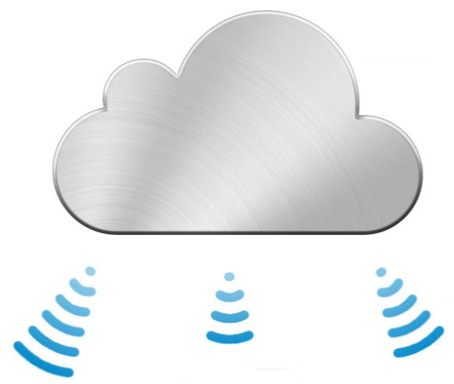
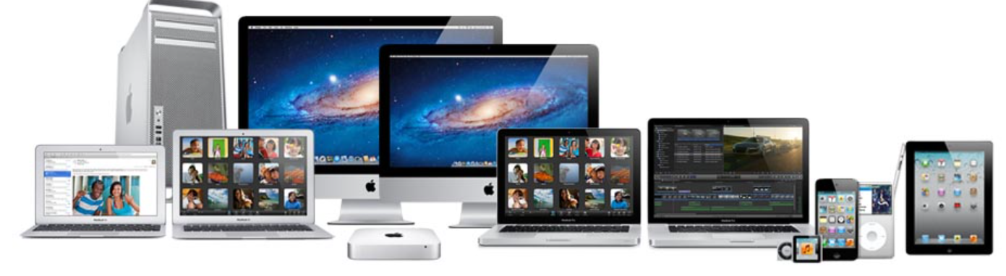
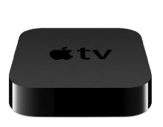
Smart phone Forensics
Data commonly found on smart phones
      With additional functionality being added almost daily, smart phones are changing how we retrieve data from mobile devices.
      Sources of data from smart phones may include;
        Email
        SMS
        Photos and Video
        Web History
        Call History
        Application Data
        eBooks
        Maps
Notes:
Integration to our daily lives
Mobile devices have become an essential part of our daily lives
Always connected - always on technology
Advance from cell phone device, to having portable music functionality to now being capable of acting as a mobile office, social tool and entertainment centre.
Most households have at least one computer but almost every occupant in the household has a mobile device.
Device is tied more closely to the user and so is the data.
CASE: Corporate client evidence located on iTunes backup.

Slide 14
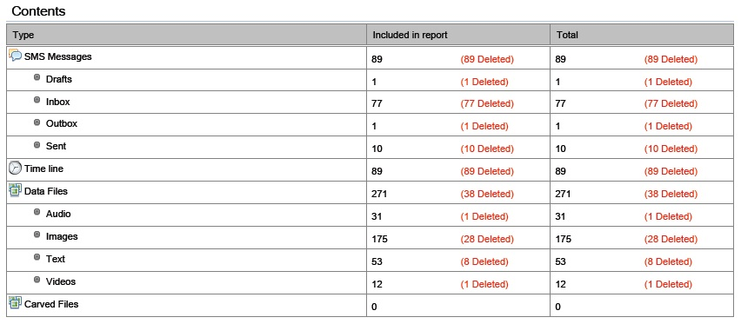
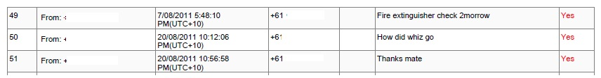
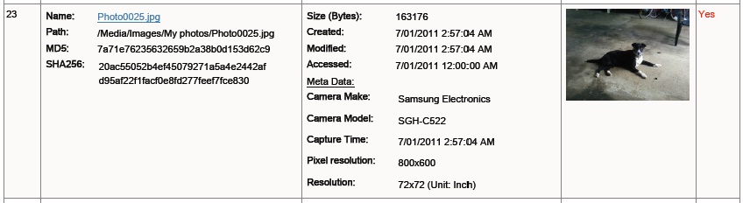
Smart phone Forensics

Slide 15
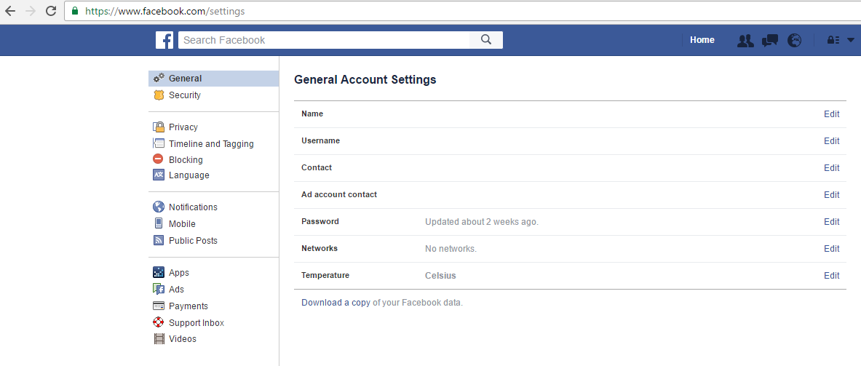
Collection and removal of Social Media
Notes:
Shows where you can download a copy of a Facebook profile (needs credentials) but will produce report where photos metadata is captured and also the IP address of the device that uploaded.

Slide 16
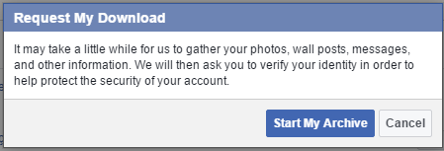
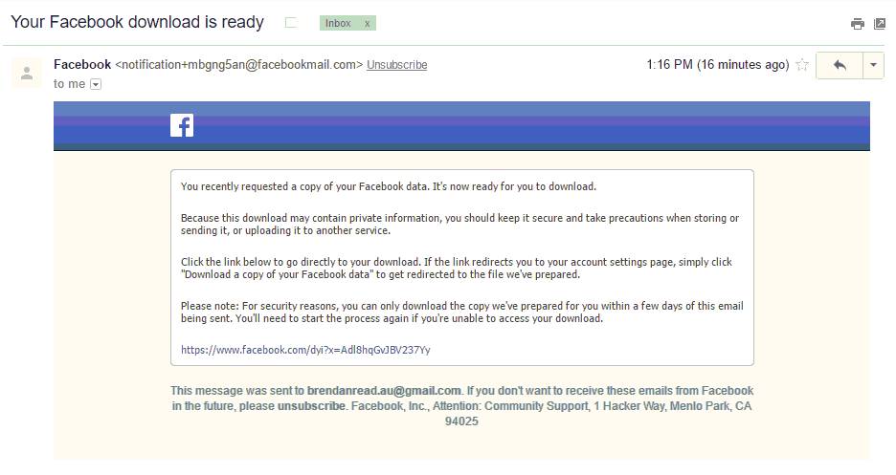
Collection and removal of Social Media
Notes:
Sample of messages from downloading FB data

Slide 17
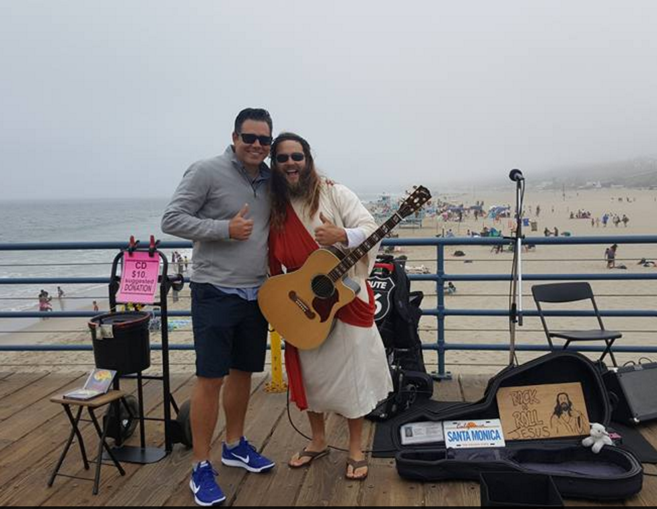
Collection and removal of Social Media
Notes:
Sample photo from my FB account

Slide 18
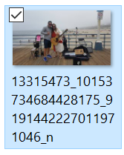
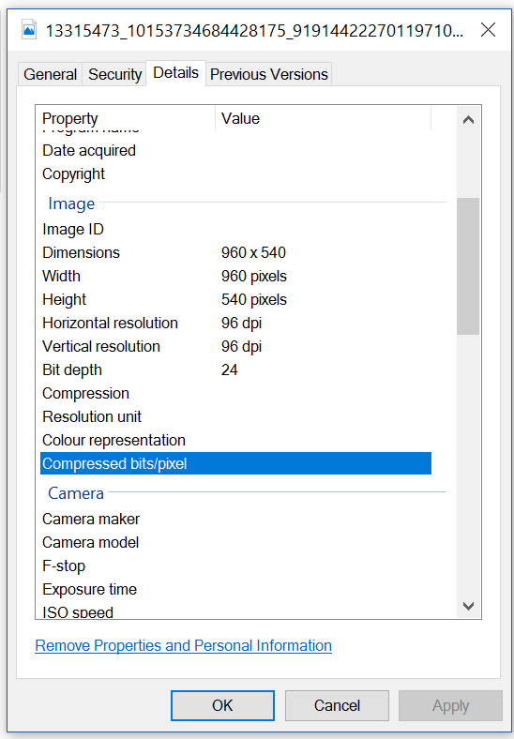
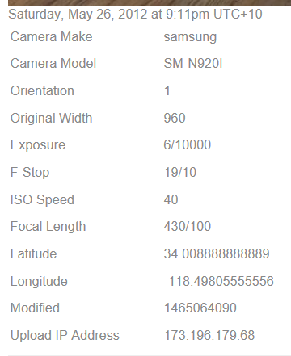
Collection and removal of Social Media
Notes:
Metadata comparison between downloading off FB page (left) compared to same photo details through profile download (on right).
Note details of Lat and Long as well as Upload IP address.

Slide 19
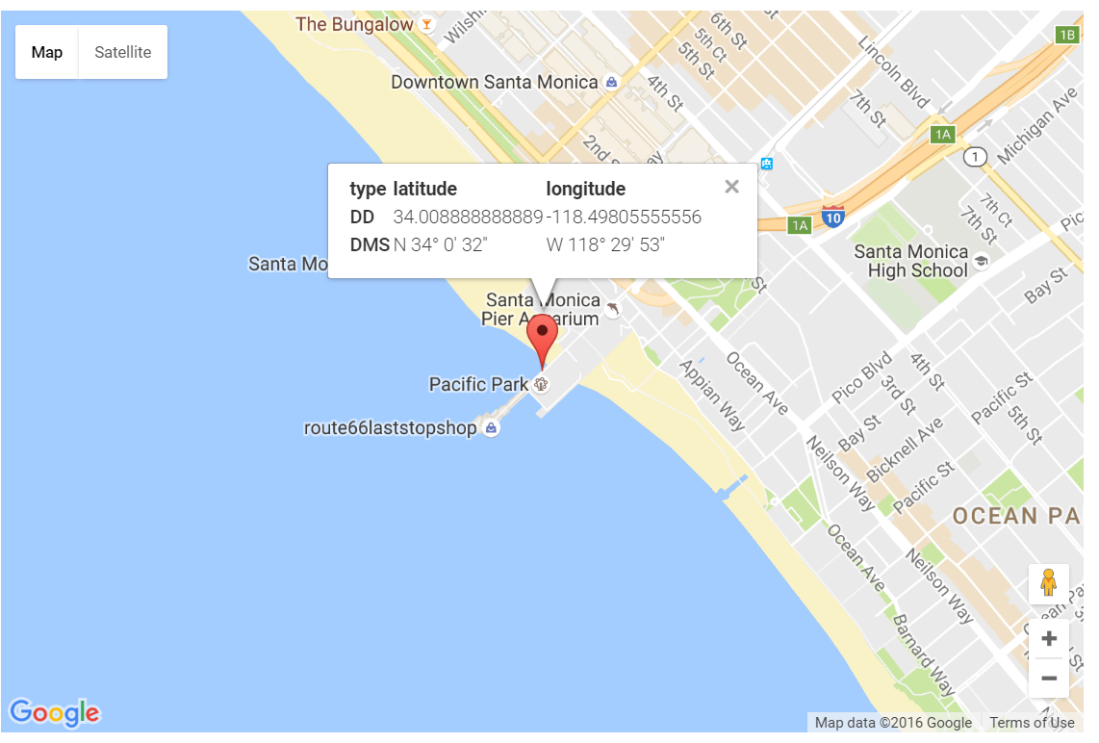
Collection and removal of Social Media
Notes:
Plot of lat and long on google maps

Slide 20
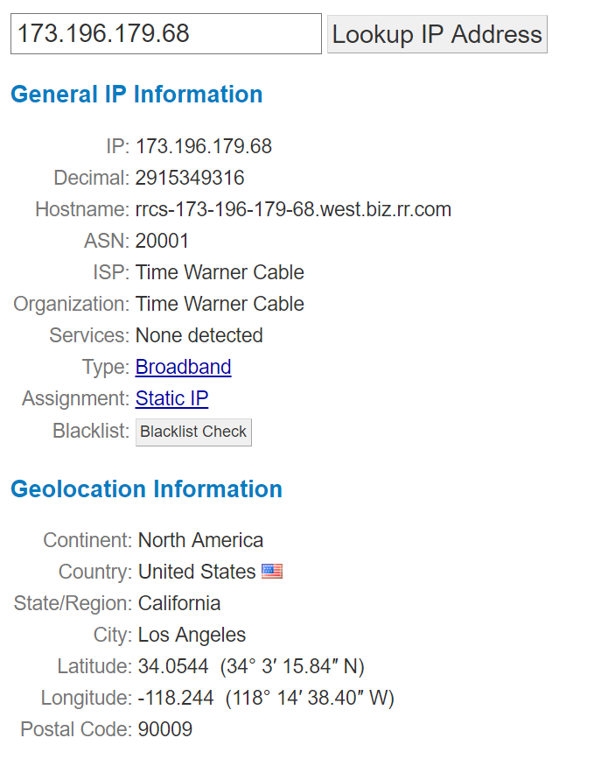
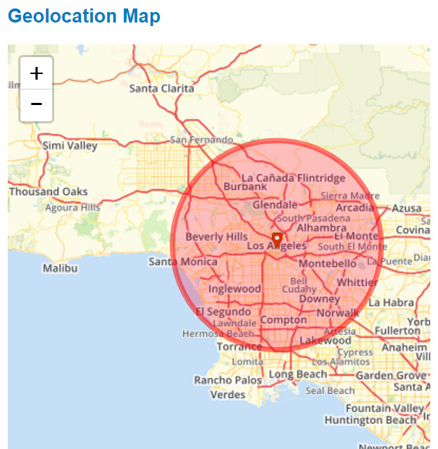
Collection and removal of Social Media
Notes:
IP upload search (this photo was uploaded while in LA)

Slide 21
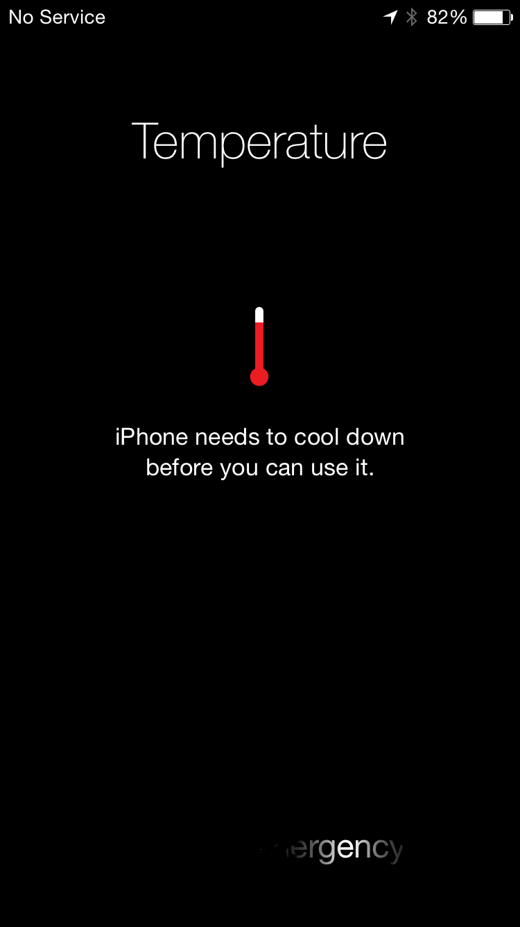
Social Media and Open Source Intellignece
Open-source intelligence (OSINT) is intelligence collected from publicly available sources. In the intelligence community (IC), the term "open" refers to overt, publicly available sources (as opposed to covert or clandestine sources); it is not related to open-source software or public intelligence.

Slide 22
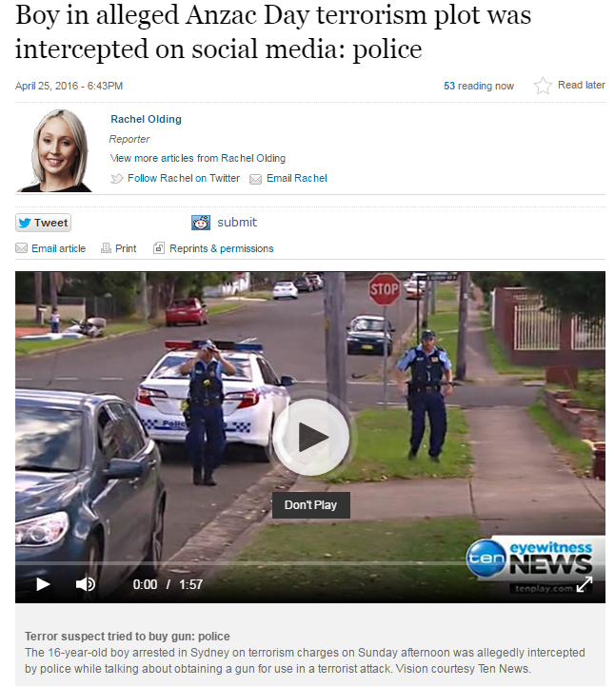
Social media
In recent times social media has been vital in serious crime investgations
“Over the last couple of decades, we’ve become skilled at collecting, preserving and producing email. But email doesn’t hold a flicker of a candle to what people post, state, admit and display in social media. So why aren’t there more products that comprehensively collect, preserve and authenticate the snowballing mounds of social media data?”
- Legaltech News
Notes:
Example of social media being used against criminal activities.

Slide 23
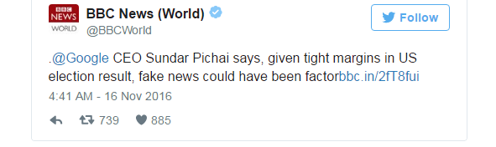
Social media trust
      Did Facebook fake news win election for Trump?
      Facebook is one of America’s top news sources?
      Most fake stories were pro trump?
      100 fake pro trump sites traced to a town in Macedonia – influence American policy?
      Facebook and Google taking steps to curb fake news.
Notes:
Example of what some people in the room may have seen when on FB. Shows how easy someone using social media can be taken off to a rip off site.

Slide 24
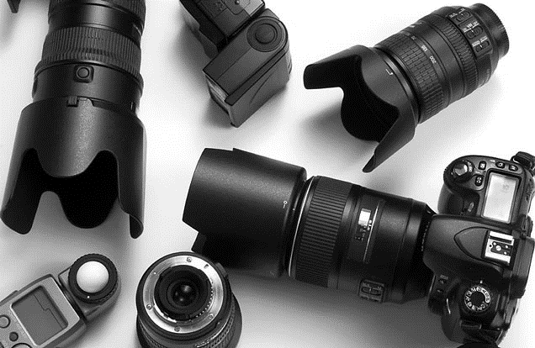
Photo Forensics

Slide 25
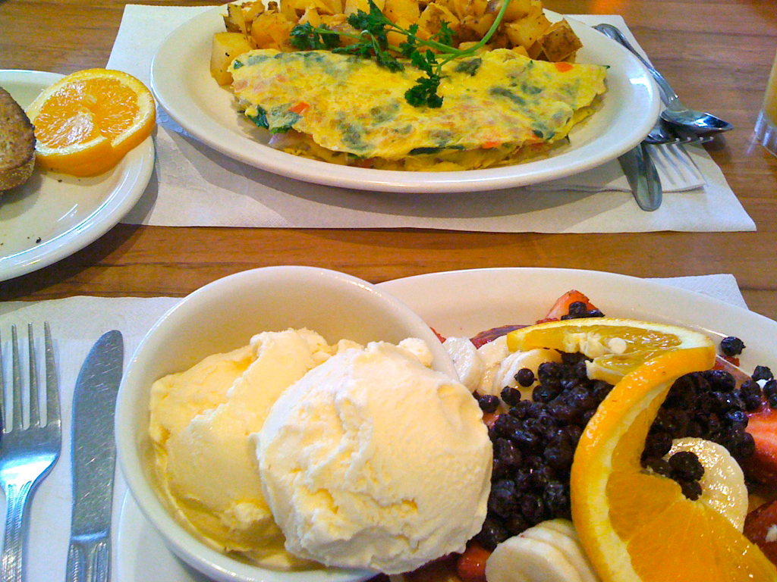
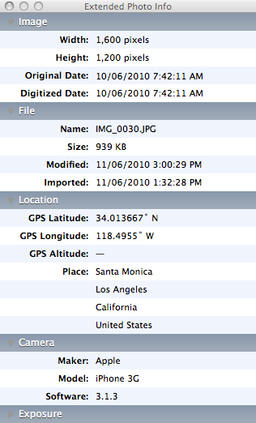
Photo Forensics
Image/photo metadata
What is metadata?
      Data about the data
Notes:
I will now discuss Multimedia Forensics. Cameras and GPS devices store large amounts of data – some of which is buried in the code of the image or video.

Slide 26
Photo Forensics
Image/photo metadata
Two types of metadata
System metadata
Application metadata
Notes:
I will now discuss Multimedia Forensics. Cameras and GPS devices store large amounts of data – some of which is buried in the code of the image or video.

Slide 27
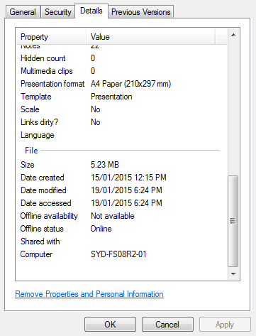
Photo Forensics
Photo metadata v system metadata
System metadata
      Metadata generated by the system
        E.g. FILE date/time
      'Forensic' procedures must be used to maintain integrity of dates
      Forensic images must be made of device
        Date created – when file first copied to that location
        Date modified – last time file was modified
        Date accessed – last time file was opened
      Date created can be AFTER date modified

Slide 28
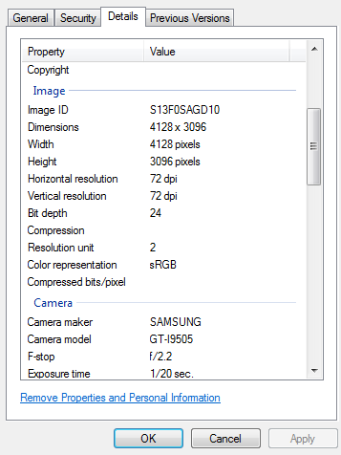
Photo Forensics
Photo metadata v System metadata
Photo metadata
      Metadata generated by the camera
        E.g. PHOTO date/time
      Generally reliable
      Most photos taken by mobile phones with date/time synced to network
      Many cameras have internal GPS activated providing a GPS date/time backup
      HOWEVER
      Dates/times can be altered/removed

Slide 29
Photo Forensics
Image/photo metadata
Rise of mobile phone photos
      The quality of photos from mobile phones has led to a massive increase in photos taken from phones.
      EXIF metadata is usually reliable due to phone syncing dates with network.
      Important fields for photo Forensics are:
        Date/time taken
        Date/time modified
        Camera make/model
        Software
        GPS date/time taken (when available)
Notes:
I will now discuss Multimedia Forensics. Cameras and GPS devices store large amounts of data – some of which is buried in the code of the image or video.

Slide 30
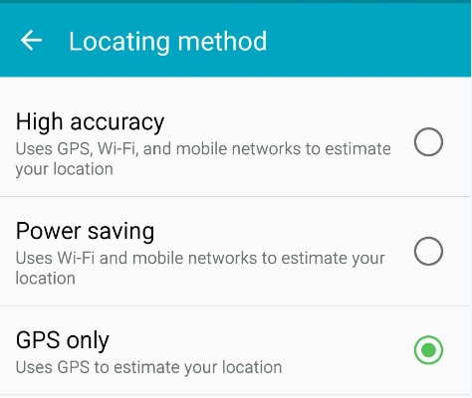
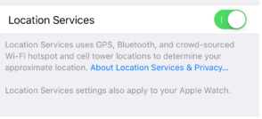
Locational Services
      Location
      Most smartphones
      Set to ‘on’ and ‘high accuracy’ by default
      Not entirely dependent on GPS satellite
        Crowd-sourced WiFi
        Bluetooth
        Cell Towers
Android
iPhone
Notes:
Most smart phones are now Geo-Tag capable. However, the user often has the option to switch this function on or off. The GPS co-ordinates are stored in raw text in the documents metadata, which can then be translated into a location via GPS locator software (as seen above) or through online GPS locators.

Slide 31
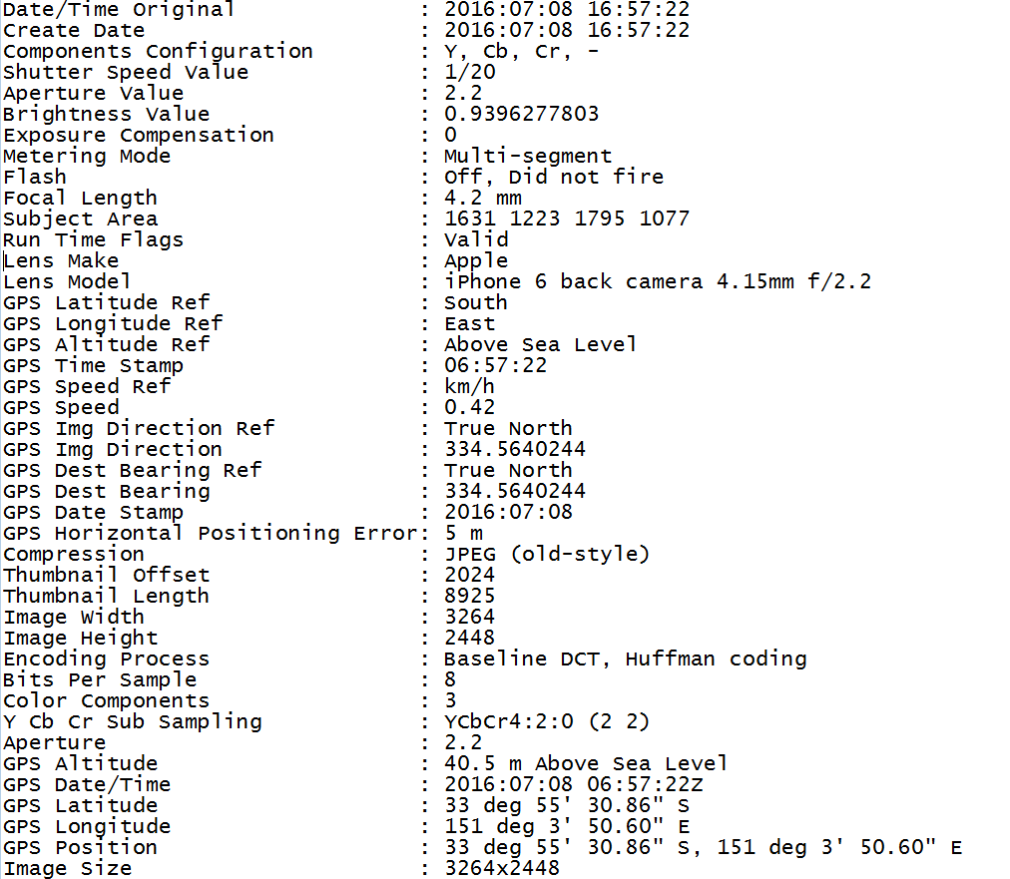
Geo tagging
Location
GPS date/time
      Activated if GPS running on mobile phone/digital camera.
      Time may be independent depending on setting on smartphone.
      Is always displayed in universal Co-ordinated time (UTC) – Greenwich mean time.
      Direction shot was taken (e.g. South East).

Slide 32
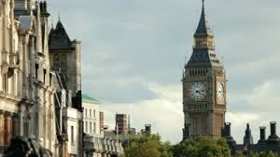
Additional observations
Additional possible observations for analysis include:
      Ambient light and/or flash – time of day
      Clocks/watches in background

Slide 33

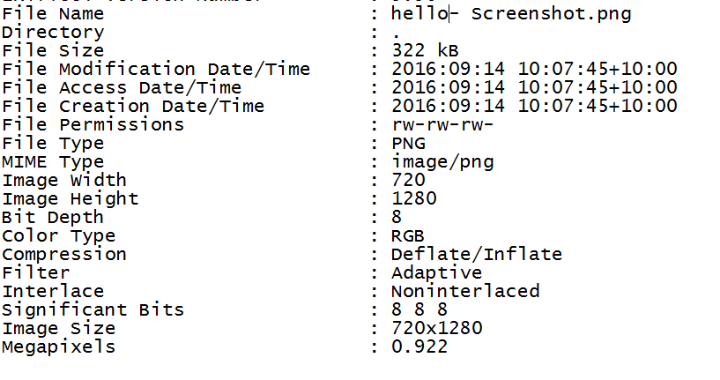
Claimant defence
Screenshot defence
      Different size to normal photograph
      Generally in .PNG format, not .JPG format
      .PNG format does not store date/time taken or most other types of EXIF metadata
      .PNG is not a standard photograph format

Slide 34
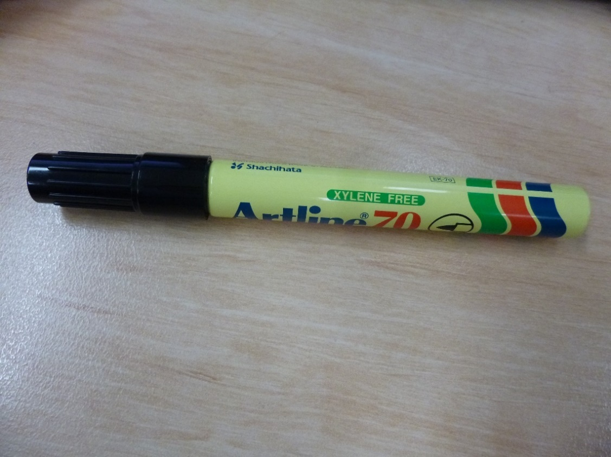
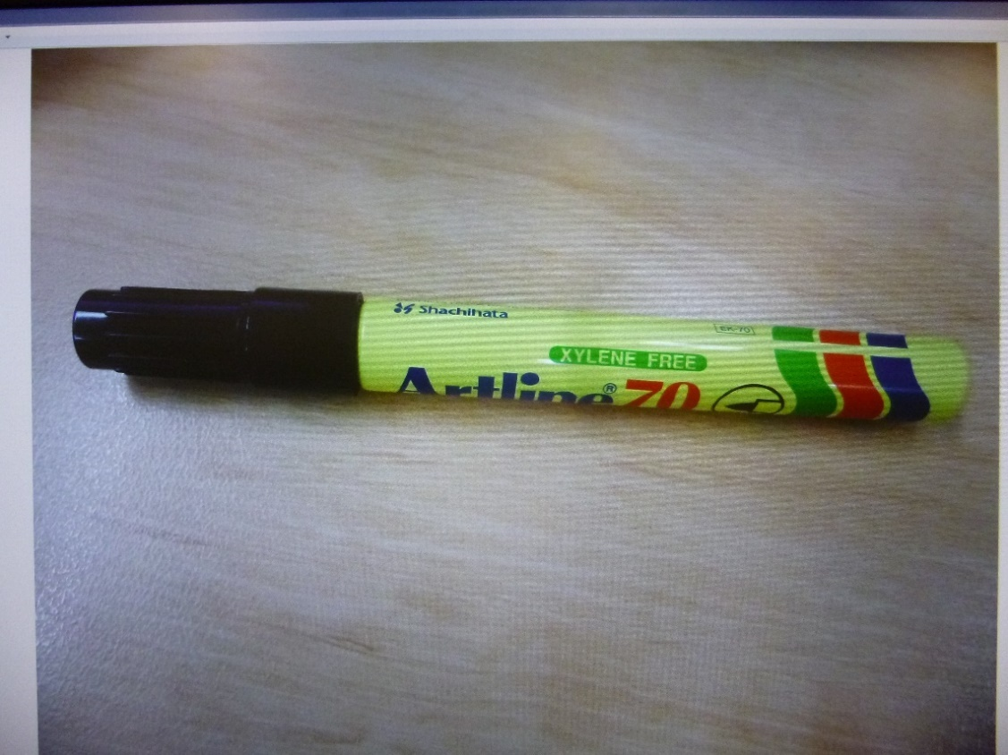
Claimant defence of date
'Photo of a photo' defence
      Backframe of a table or other flat surface around the original photographs
      Light reflection from the original photographs
      Obvious curvature from the original photographs
      Obvious pixellation or rosetta marks (repeated tiny patterns in the way that ink is distributed) when zooming into the photographs
Photo
Photo of Photo

Slide 35
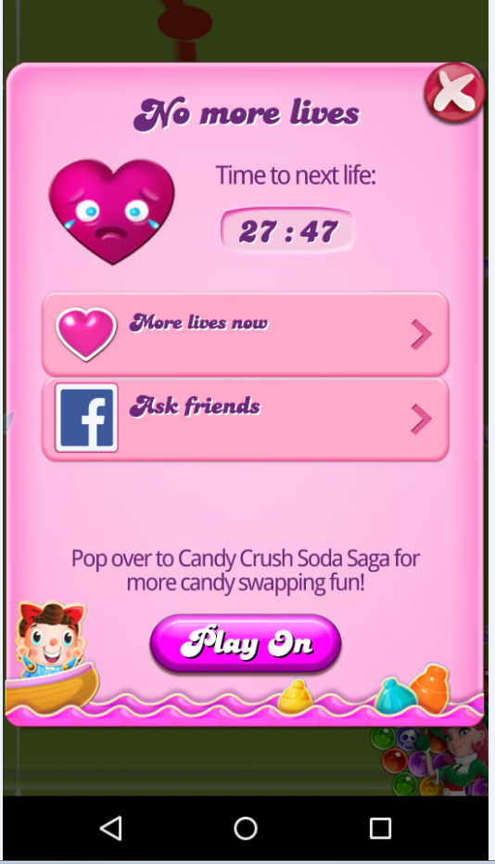
Claimant defence of date
'Candy Crush' defence
      Users wind clock on mobile phone x amount of hours forward to continue playing game (don’t have to wait)
      Longer forward = more lives
      Could possibly be a valid argument for motor vehicle accident

Slide 36
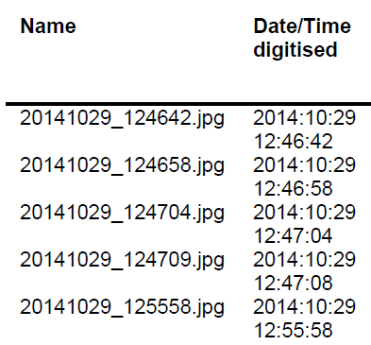
Case study – failed 'Candy crush' defence
      Insurance taken out by claimant at 13:30 on the 29th of October. Accident reported to insurer that it occurred at 15:00.
      Claimant advised Insurer that times were inaccurate due to moving time because of candy crush.
      Date/time taken was before the claimant reported it occurred.

Slide 37
Case study – Digital Forensics
      We were originally provided some photos from a client for photo Forensic analysis via email where the photos appeared stripped of metadata.
      Claim was for a loss of jewellery in August 2012.
      The Insured then provided a USB thumb drive to support his claim. A review of the USB thumb drive identified 67 digital images. These images were recorded as been exposed with a JVC GZ-MG30 digital camera.
      Once the USB drive was imaged, we identified an additional 19 photos which had been deleted from the drive.
      These 19 photos appeared to be apart of a large sequence of photos, based on the names and date taken of the photographs.

Slide 38
Case study – Digital Forensics
Power of digital Forensics

Slide 39
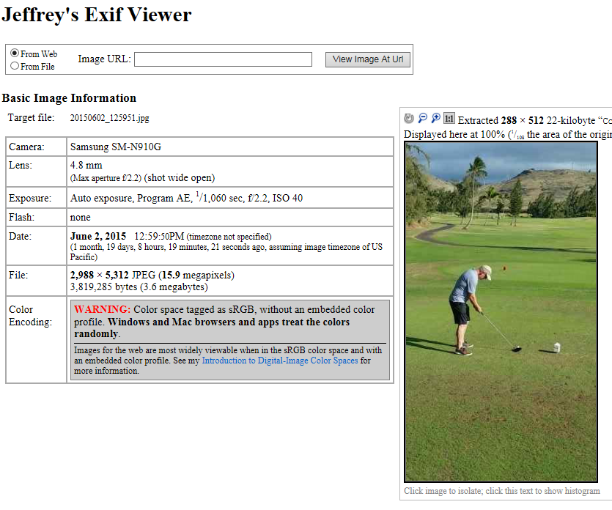
Online EXIF metadata websites and confidential information
      Various websites can provide almost instant access to EXIF information including:
        Jeffrey’s EXIF viewer (http://regex.info/exif.cgi)
        FotoForensics (http://fotoForensics.com/)
        MetaPicz (http://metapicz.com/#landing)
      These websites provide a user with access to a photograph’s EXIF metadata.
      Privacy/confidentiality concerns from these sites. Where are these photos being stored and once they are uploaded, who has access to them?

Slide 40
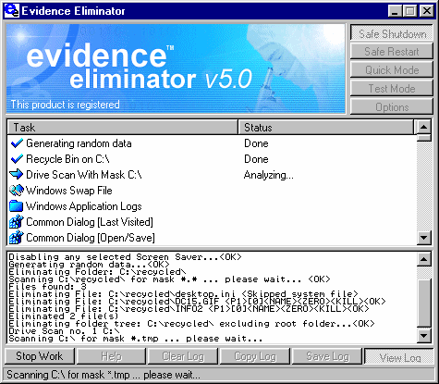
Anti Forensic tools
Anti Forensics - evidence of deliberate destruction can itself be evidence
We can <sometimes> detect:
      Use of cleaning tools
      Use of wiping tools
      Date/time of use
      Even when a drive is completely wiped this can itself be useful evidence

Slide 41

Other work we are seeing – Cyber Fraud /Insurance

Slide 42
Questions?
Contact details
Tim Myers Nigel Carson
Director Partner
+61 2 8257 3076 +61 2 8257 3080
tmyers@kordamentha.com ncarson@kordamentha.com

