Slide 1




International Association of Auto Theft Investigators
Hans Kooijman
International President, IAATI

Slide 2

IAATI
International Association of Auto Theft Investigators
Melbourne, April 2017

Slide 3

Brief History
Formed in 1952 in the USA.
.In order to improve communication and coordination among the growing family of professional auto theft investigators.
.It has grown to almost 4.000 members representing wold wide.
.Includes representatives of law enforcement agencies, as well as many others with a legitimate interest in auto theft investigation, prevention and education.
We recognize that, just as law enforcement agencies cannot successfully function independent of one another, auto theft investigation requires the active participation of the private sector.
.This includes the Insurance industry, vehicle manufacturers, car rental companies and, of course, the National Insurance Crime Bureau and its sister agencies in Canada and Europe.
6 Chapters in USA /Canada and Branches in , Australia New Zealand Asia (Australasian) , South Africa, Latin America, United Kingdom and Europe.

Slide 4
Personal Introduction- Hans Kooijman
:President IAATI 2016-2017
.1970 until 1980 Rotterdam Police Officer( Both uniform and as a detective)
.1981 until 1985 Customs & Excise and NCB
( Interpol) in the Hague.
.1985 Insurance claims investigator.
. Presently I am manager of the Insurance Claims Investigations team of Allianz Nederland Groep
.Like many IAATI members I am still active on investigations in the field on a daily basis.
.I am past president of IAATI European Branch. (2009/2011) and still EB- board member

Slide 5
Case Study- 1
On the 22nd July 2013 at 09.17hrs an Italian GPS tracking company was seeking assistance with the recent theft of 9 items of construction equipment from North Italy…….

Slide 6
GPS tracking indicated that the machines were already in Hungary in a services area

Slide 7
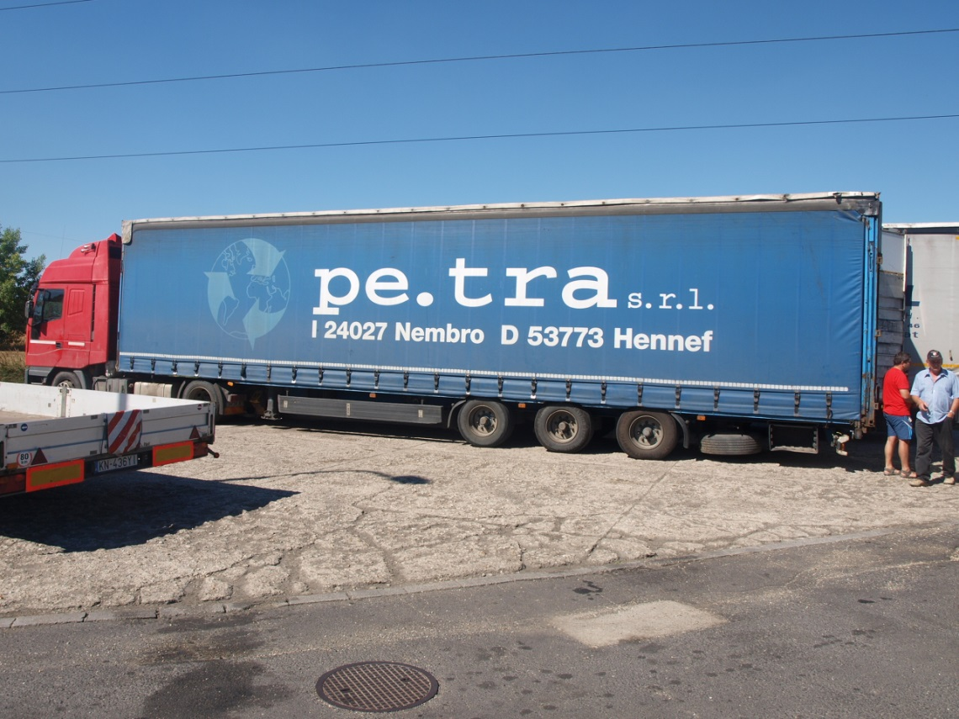
The request for help was picked up by the Police Liaison Officer for Datatag in the UK. He contacted another IAATI member, who was a German national but based in Budapest.
That member was able to use his local contacts within Hungarian law enforcement to deploy units and pin point the machines concealed within a 40 ft lorry trailer, still at the service area.

Slide 8
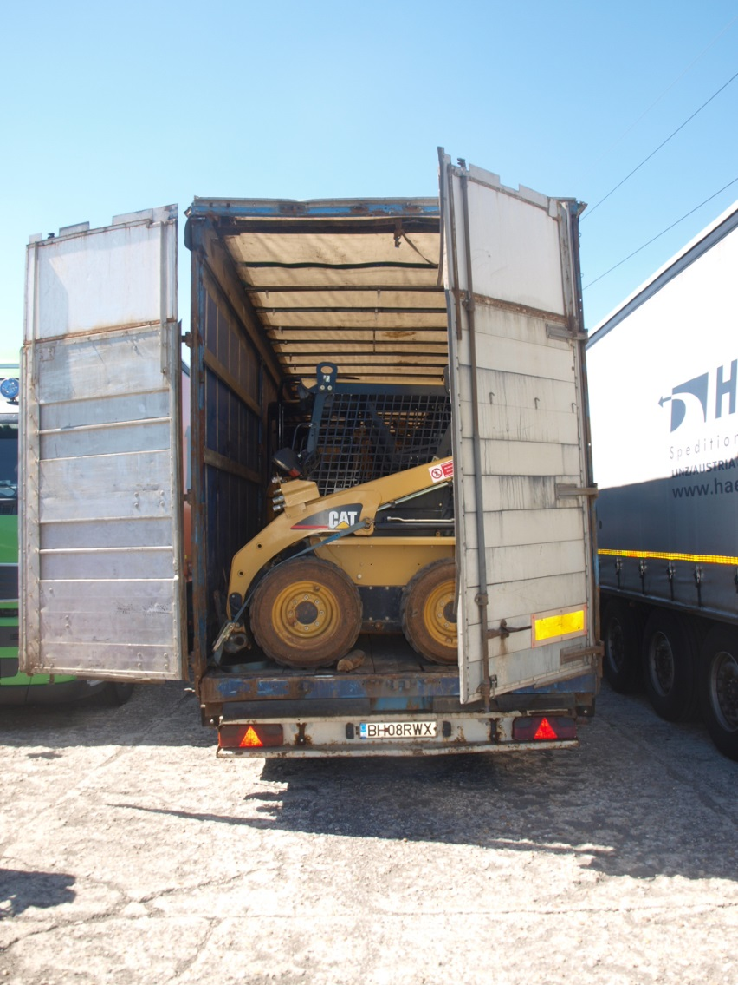
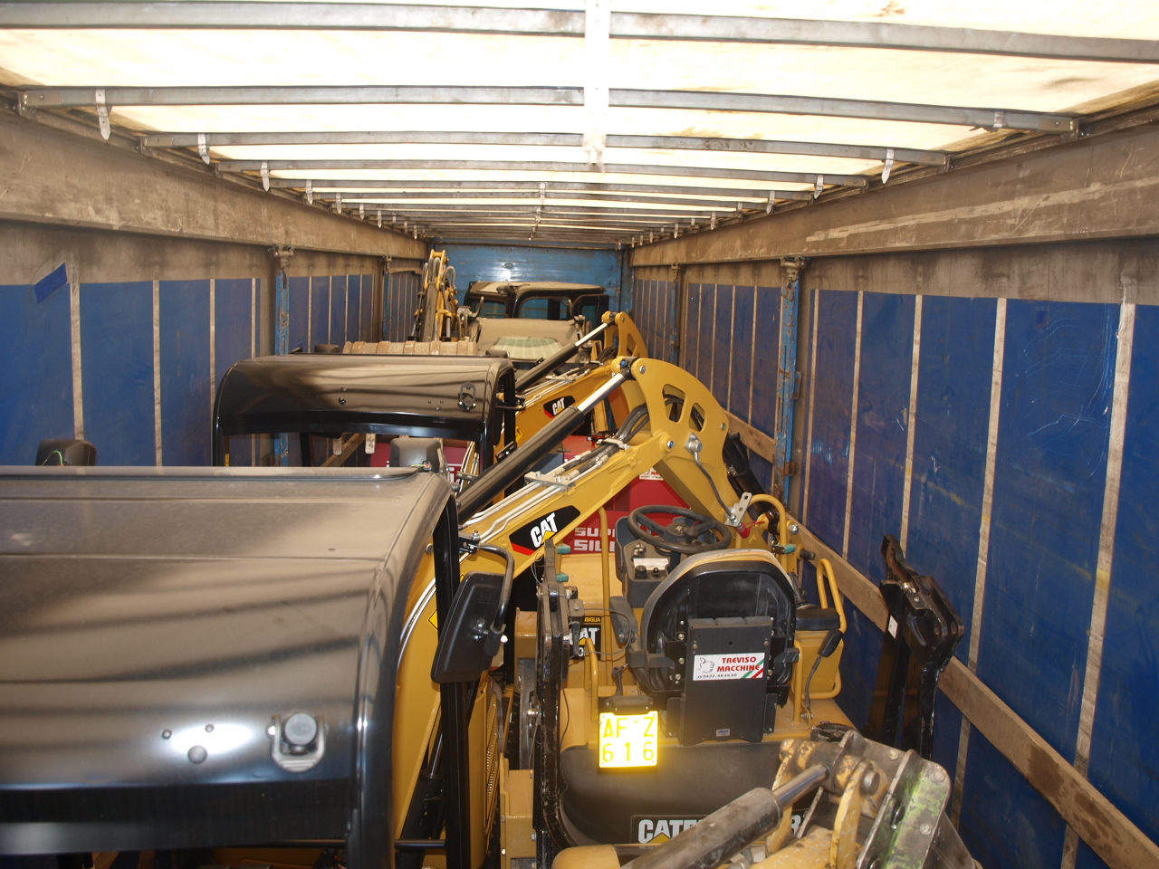
Examination of the lorry revealed
7 of the 9 Items of the stolen equipment

Slide 9
With support from the IAATI members the Tachographs of the lorry were overlaid with the GPS tracking information. With the timings and distances it was possible to show the lorry had been at the scene of the theft when it was taking place.
A further urgent call from the Italian tracking company in the early afternoon, stating the machines were moving again, and asking for assistance to stop them, was met by the response that
‘we know as they are on way to the Police compound !’

Slide 10
Case Study- 2
On the 4th April 2012 a BMW M3 was reported stolen as a result of a burglary.
The matter was reported to the Carabinieri at Roma Acilia.
The car was recorded as being blue in colour.

Slide 11
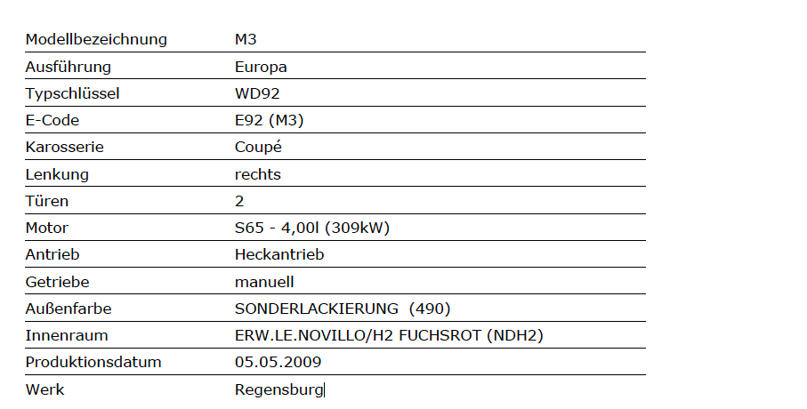
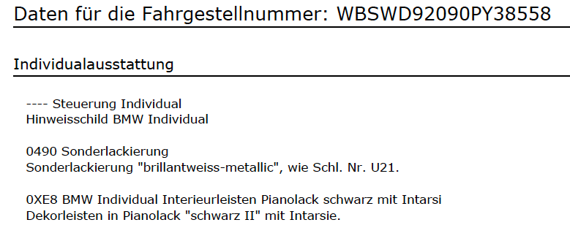
Car Details
BMW M3 VIN WBSWD92090PY38558
Registered in Italy 12.09.2011

Slide 12
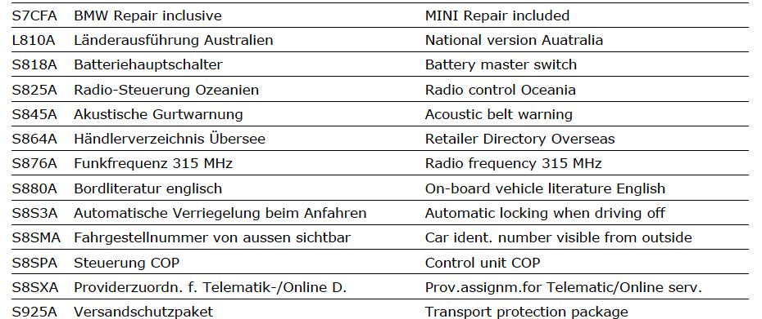
Car Details

Slide 13
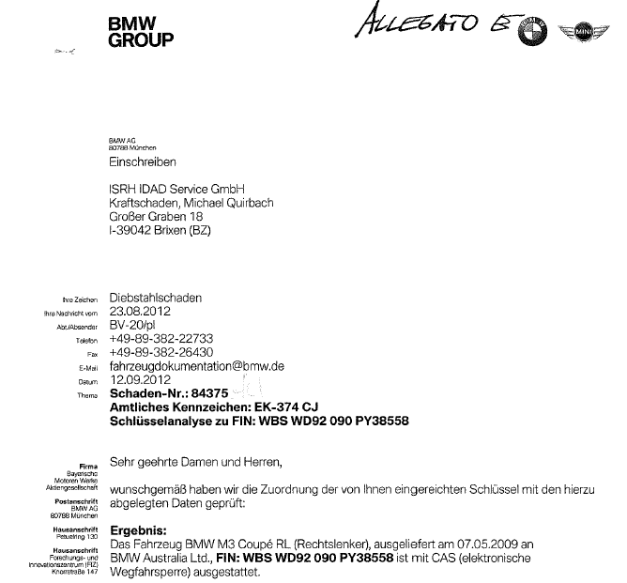
Year of production 2009
Delivery date (confirmed by BMW)
May 2009 made for and despatched to Australia
Car Details

Slide 14
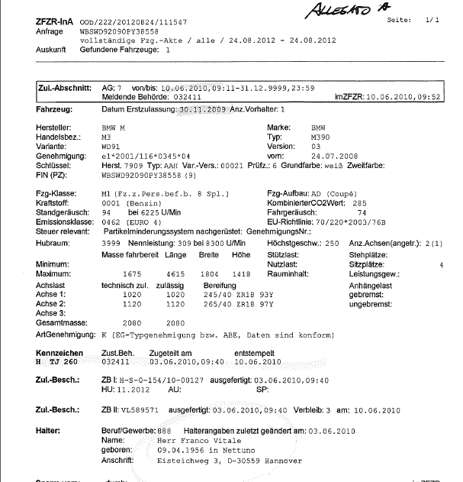
Car History Details
3rd June 2010 the car was registered in Germany.
The car issued with the German registration number HTJ260
Deregistered in Germany
June 10th 2010
The registration holders address was an Italian coffee bar

Slide 15
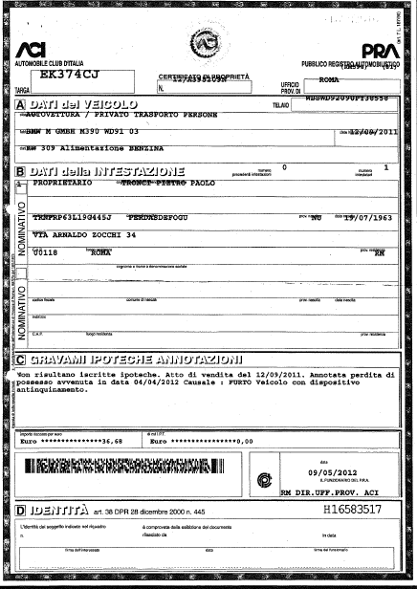
Car History Details
The car was registered in Italy as an import from Germany on 12 September 2011
Registration office and insurance company did not inspect the car
The car obtains an original Italian registration and documents.

Slide 16
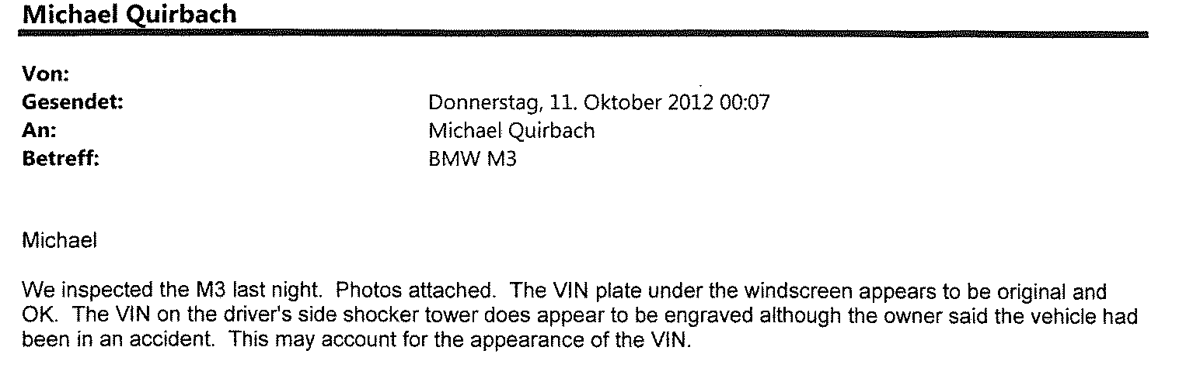
IAATI Investigation
11th October 2012 via IAATI network Australian Police force inspect and take pictures of the original car in Australia

Slide 17
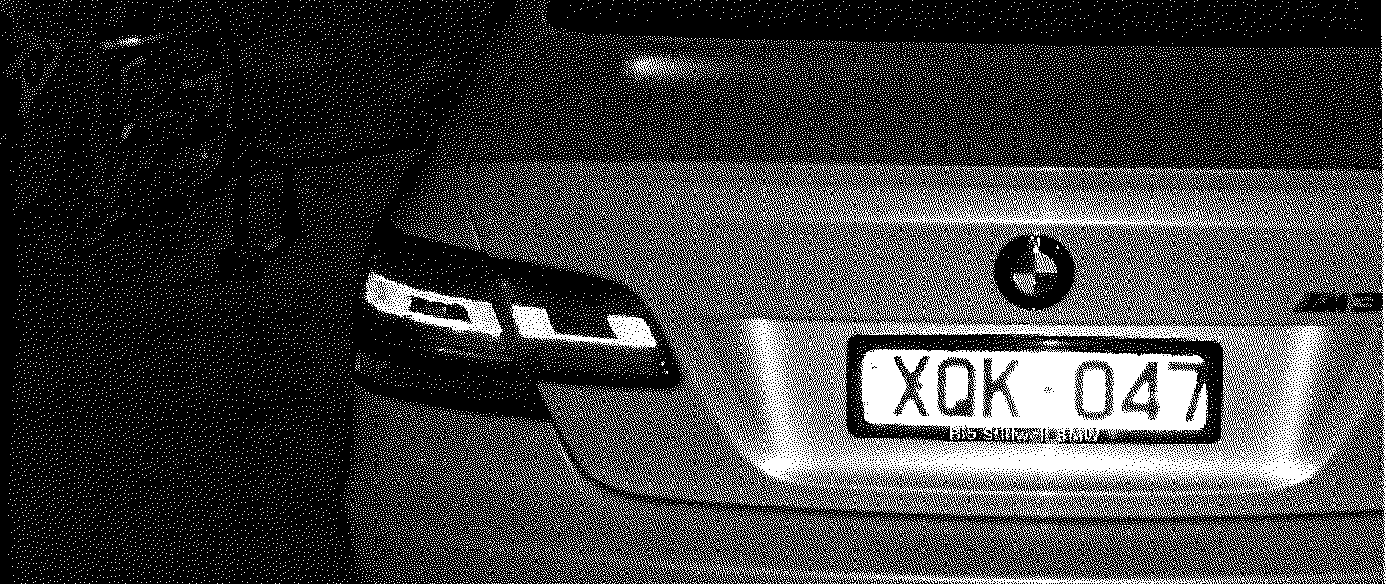
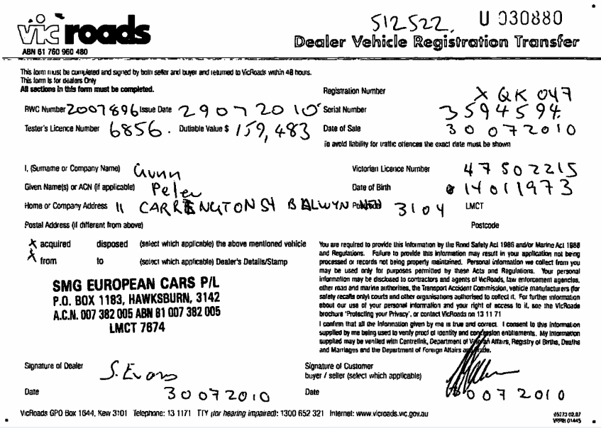
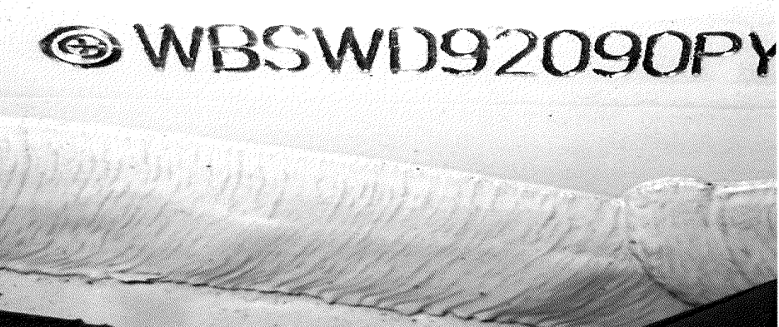
Australian Original car

Slide 18
Result
With the support of IAATI NETWORK the insurers were able to prove that the car originally was sold in Australia. At the moment of registration in two diferent European countries the original car was was still registered and physically present in Australia.
Key examination of the reported stolen car revealed that the car had not been physically cloned. A ‘paper car‘ had been generated purely to commit Insurance fraud.
The investigation failed to prove any connection between Australia and European criminals using the false details.

Slide 19
Case Study- 3
Concerns the thefts of BMW X5 BMW X6 Landrover Rangerover and Lexus motor vehicles.
One of the Dutch IAATI members came into contact with members of the border Police of Frankfurt Oder ( Germany)
Frankfurt Oder is on the border of Germany and Poland. Intelligence shows Lithuanian criminals are involved. Initially the stolen cars go to Lithuania and from there they are forwarded to other countries such as Russia.
The German border police had noticed that less stolen cars were actually being intercepted as they were driven over the border.

Slide 20
The Problem
The IAATI member informed the border Police that he suspected that the stolen cars were being concealed and transported inside lorries.
The border police agreed that they had noticed an increase in Lithuanian lorries crossing the border. However most of them were sealed with a Customs seal.
Due to the nature of the load and the special need for a Custom seal these lorries are not controlled by the police in respect of their goods. Breaking a customs seal requires a customs officer to be physically present at the time of opening.
However such lorry drivers should have a T or TIR document to cover the load and these documents must always be available for inspection.

Slide 21
The Problem
The IAATI member told the police that he had information that false customs seals were being used on the lorries to stop routine Police inspections.
The border Police stopped the next suspect Lithuanian lorry. Again as before, it was sealed with a customs seal.
The lorry was detained and the assistance of a Customs officer was requested.
The driver only could hand over a CMR document. It was a document written in Lithuanian language only, and it declared the load was 6 tons of iron.
Although the lorry was sealed, the driver did not have a custom document.
For that reason the customs broke the seal and inspected the load.

Slide 22
Result
Inside the lorry they found a stolen
BMW X6
Rangerover Sport
Both cars were recently stolen from Holland.
The custom seal was a complete fake.
A simple commercial / public exchange of information led to an excellent instant result. That in turn has allowed for a new method of transportation to be discovered and working practices amended accordingly and shared amongst Law enforcement.

Slide 23
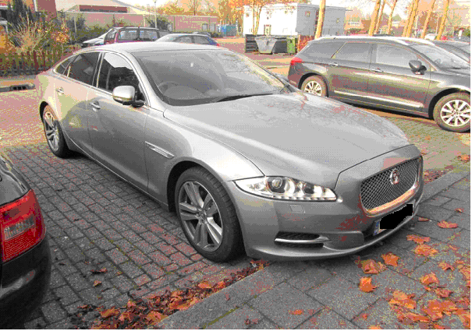
The IAATI network is very important !

Slide 24
The Heart of IAATI
Is the ability to exchange information in a ‘Timely’ Manner.
To be able to request and access information from a range of experts in a range of different auto crime related matters.
For commercial and law enforcement to work alongside one another to achieve a positive outcome
To respect each countries laws and procedures
Being transparent and accountable to anyone making a reasonable request
Most branches operate an Internet based forum exclusively for its membership
A continuing process of training and awareness in all matters concerning Auto Crime.

Slide 25
A new problem
Stealing for parts
Parts are difficult to identify

Slide 26
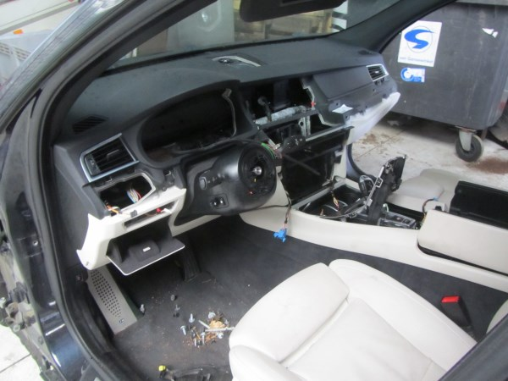
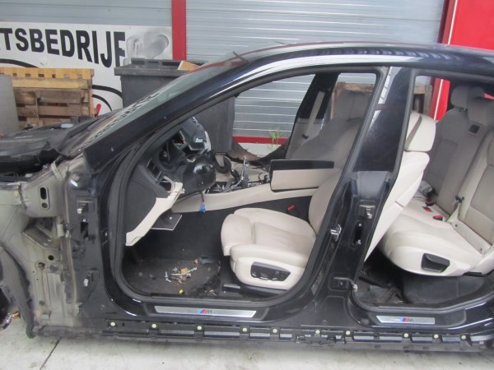
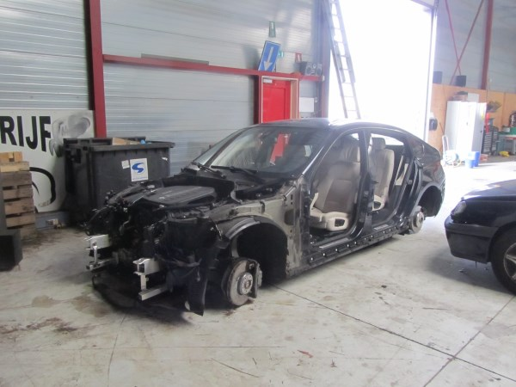
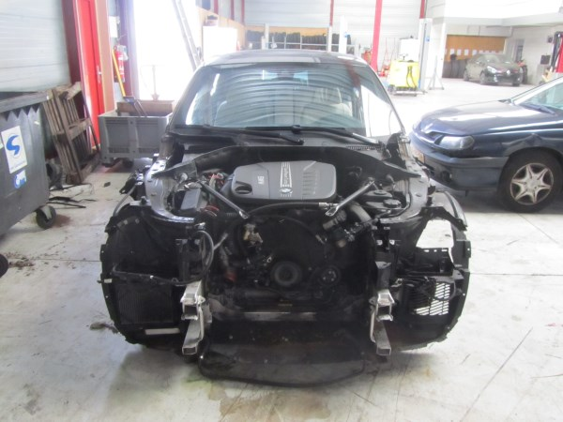

Slide 27
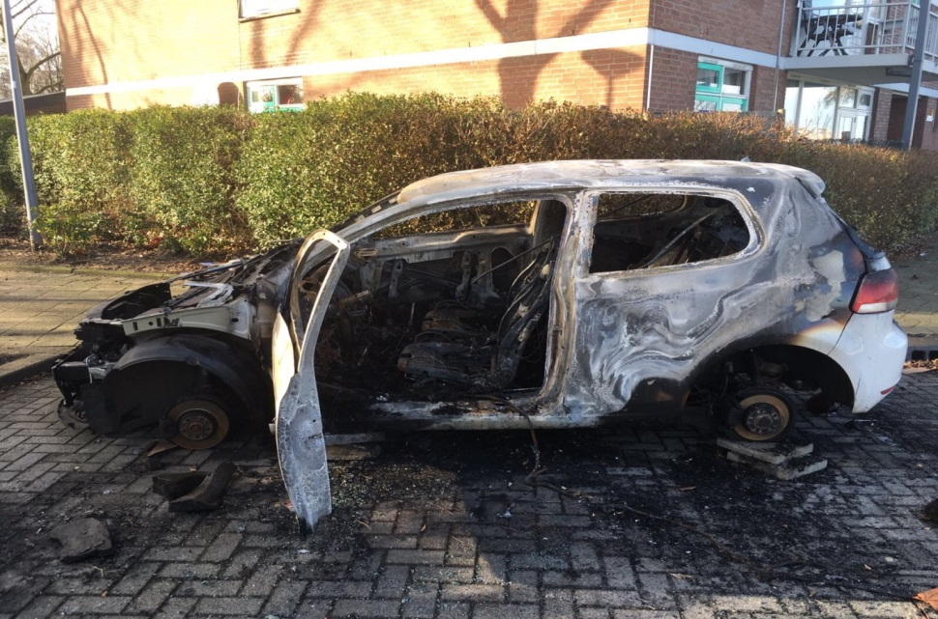
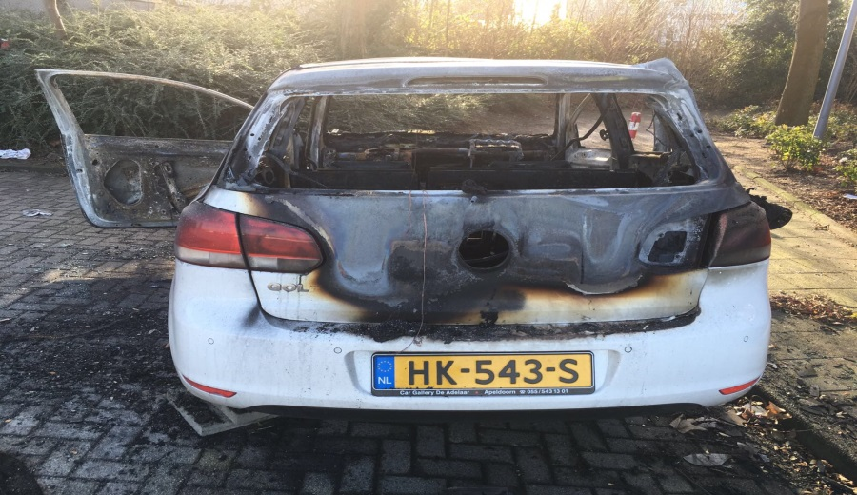
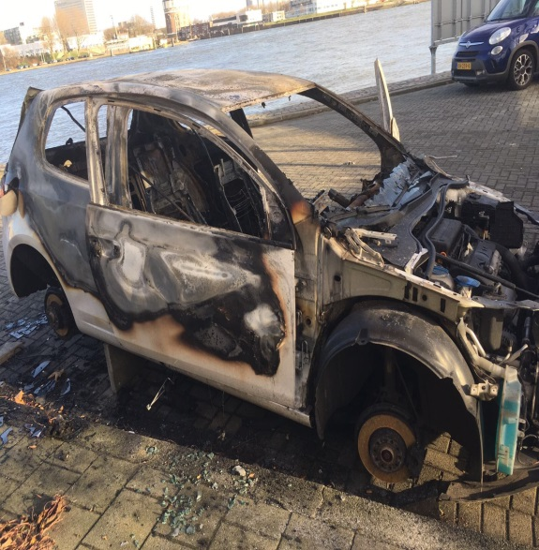
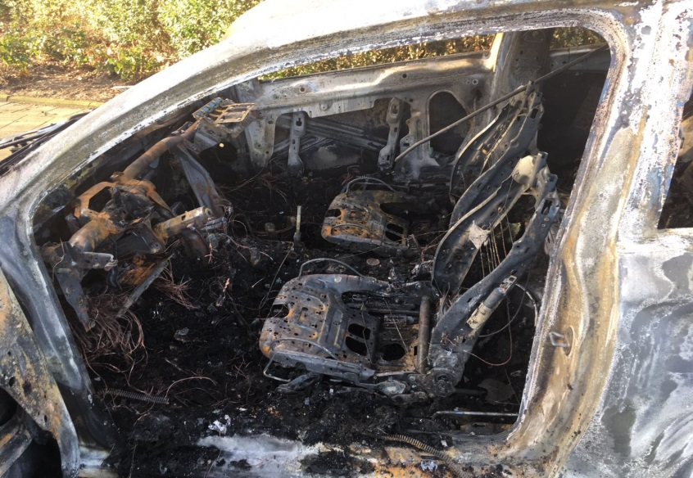

Slide 28
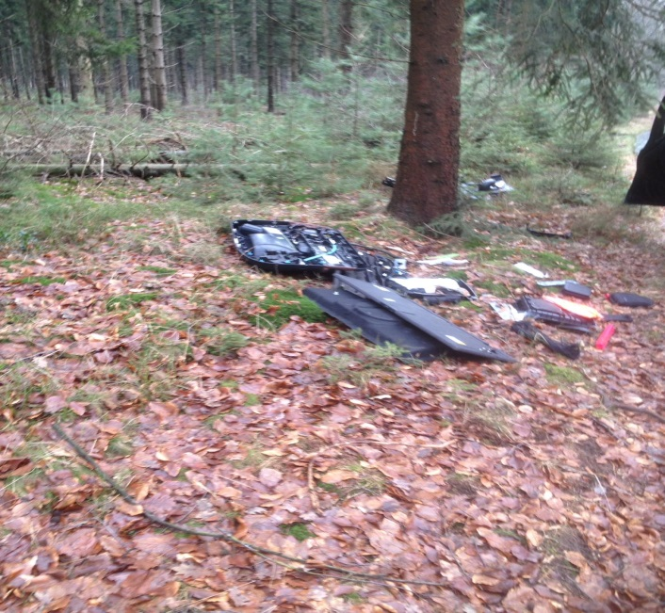
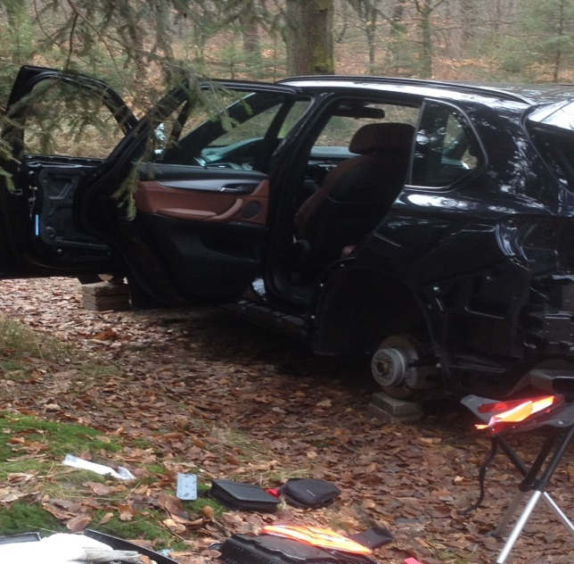
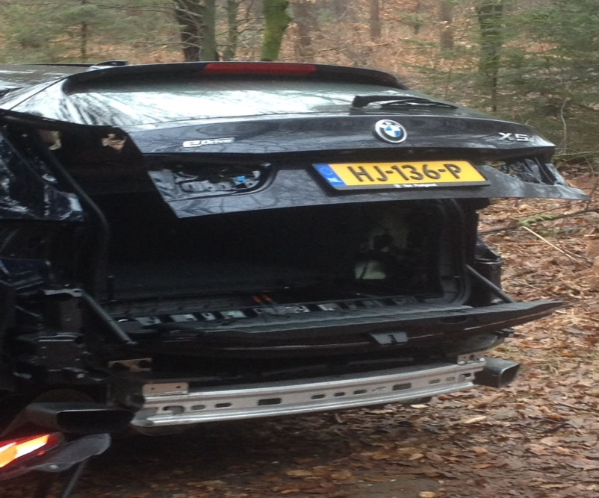

Slide 29
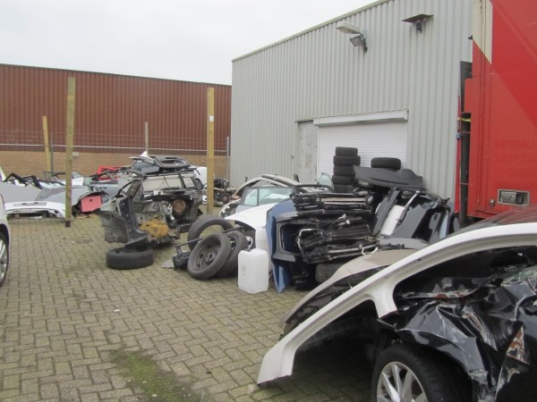
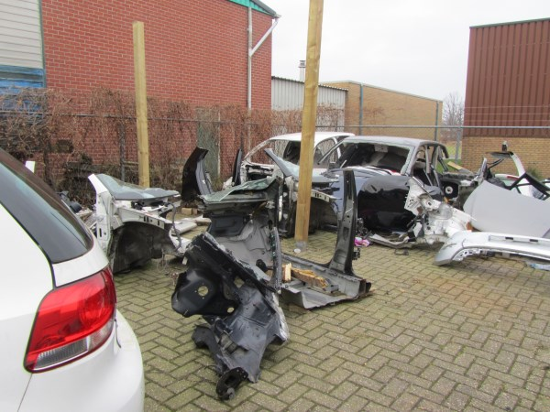
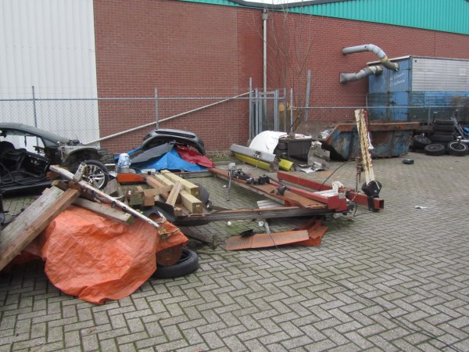
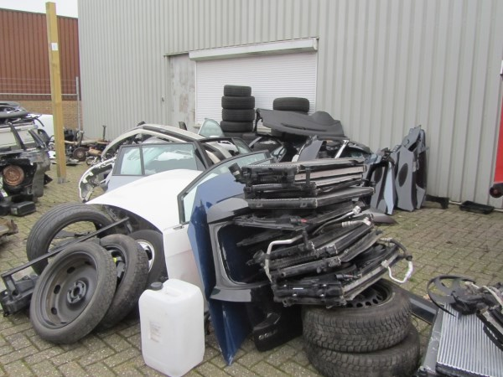

Slide 30
Favorite Brands
Audi
Volkswagen
BMW
Mercedes

Slide 31
Where do this parts go to ?
All over the world ! But don’t think too far. You can find them around the corner, on EBAY, Facebook, and so on

Slide 32
Can we stop this ?
Only if we can identify those parts.
Microdots or Chips
Cooperation from the car manufacturers
Legislation

Slide 33
Thank you for your attention

